Slide 1
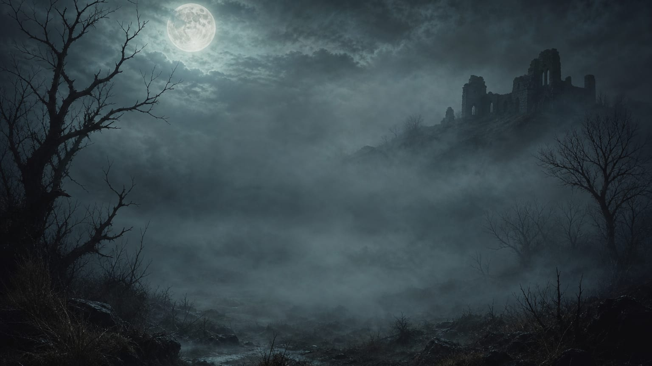
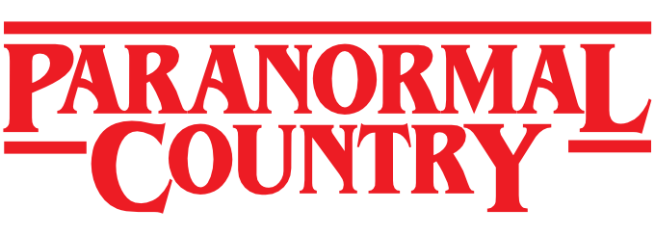
A VISUAL TOUR OF
PARANORMAL COUNTRY
Discover places. Document carefully. Meet safely. Build a community that takes the unexplained seriously.
32-SLIDE PLATFORM PRESENTATION
paranormalcountry.com
Notes:
Open with the central proposition: Paranormal Country is the social home for people who take the unexplained seriously.
Explain that the presentation uses real screenshots to show how the platform moves from discovery and responsible reporting into community and real-world connection.

Slide 2
WHAT PARANORMAL COUNTRY IS
02
A serious community without the chaos
A focused home for exploring the unexplained without ridicule, clickbait or exploitation.
EXPERIENCERS
Tell what happened in your own words and keep control of what you share.
THE PROMISE
Free to join
No advertising
No selling personal information
Community-led development
INVESTIGATORS
Organise reports, evidence, cases, methods and local collaboration.
CREATORS
Build a public presence, publish media and connect with supporters.
THE CURIOUS
Learn, explore and take part without needing to claim certainty.
PARANORMALCOUNTRY.COM
MISSION • EXPLORE • INVESTIGATE • BELIEVE
Notes:
Paranormal Country is built for experiencers, investigators, creators and curious people who want a focused place to explore the unexplained.
The platform aims for meaningful discussion and real connection rather than engagement at any cost.
Emphasise the public promise: free access, no advertising and no sale of personal information.

Slide 3
THE MEMBER JOURNEY
03
One platform, one continuous journey
Each stage creates the reason for the next.
01
02
03
04
DISCOVER
DOCUMENT
MEET
BELONG
Find haunted places, trails and activity around you.
Capture reports, evidence and context carefully.
Join investigations, events, venues and local crews.
Build friendships, groups, skills and recognition.
Tools organise research — they do not claim to prove paranormal phenomena.
PARANORMALCOUNTRY.COM
JOURNEY • EXPLORE • INVESTIGATE • BELIEVE
Notes:
Use this slide to frame the rest of the presentation.
The experience starts with discovery, moves into careful documentation, creates opportunities to meet and ultimately builds belonging.
State clearly that the platform organises research and discussion; it does not claim that a tool can prove a paranormal event.

Slide 4
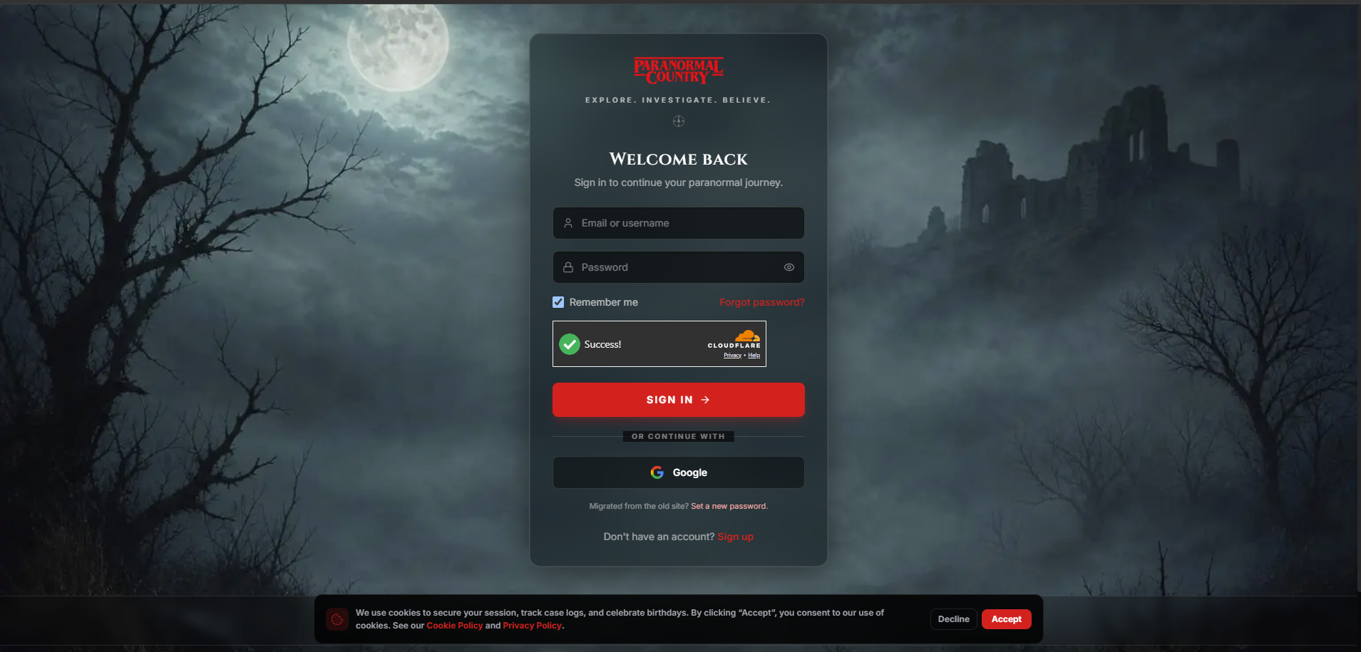
MEMBERSHIP
04
Homepage and secure access
A clear, cinematic entry point into the member experience.
FEATURE SUMMARY
The homepage gives members a focused sign-in route while preserving the dark Paranormal Country identity. Account recovery, Google access and signup are kept in one place.
TALKING POINTS
Simple sign-in and account recovery
Google login and free signup routes
Visible privacy and cookie controls
LIVE PLATFORM VIEW · JULY 2026
PARANORMALCOUNTRY.COM
MEMBERSHIP • EXPLORE • INVESTIGATE • BELIEVE
Notes:
A clear, cinematic entry point into the member experience.
The homepage gives members a focused sign-in route while preserving the dark Paranormal Country identity. Account recovery, Google access and signup are kept in one place.
Talking points:
• Simple sign-in and account recovery
• Google login and free signup routes
• Visible privacy and cookie controls
Presenter guidance:
This is the front door to Paranormal Country. It keeps the first interaction simple and recognisable, while giving returning members, migrated users and new signups clear routes into the platform.

Slide 5
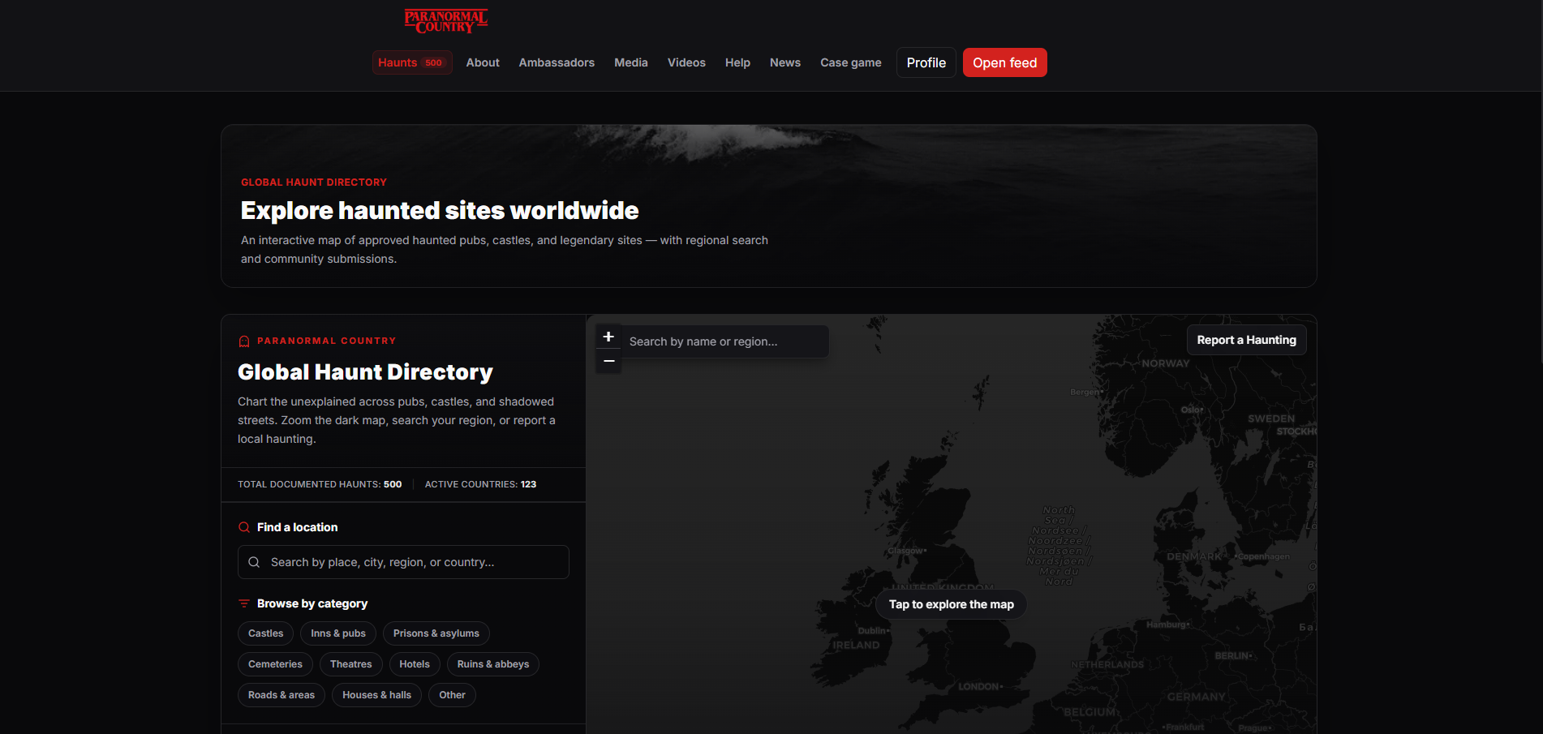
DISCOVER
05
Global Haunt Directory
Search approved haunted places and explore them on an interactive map.
FEATURE SUMMARY
The directory brings pubs, castles, cemeteries and legendary sites into one searchable location. Visitors can browse by category, search a region or suggest a new haunting for review.
TALKING POINTS
Interactive map and regional search
Categories make browsing practical
Community submissions are reviewed
LIVE PLATFORM VIEW · JULY 2026
PARANORMALCOUNTRY.COM
DISCOVER • EXPLORE • INVESTIGATE • BELIEVE
Notes:
Search approved haunted places and explore them on an interactive map.
The directory brings pubs, castles, cemeteries and legendary sites into one searchable location. Visitors can browse by category, search a region or suggest a new haunting for review.
Talking points:
• Interactive map and regional search
• Categories make browsing practical
• Community submissions are reviewed
Presenter guidance:
The directory is one of the strongest public discovery tools. It turns individual location pages into a connected map and gives the community a controlled way to help expand coverage.

Slide 6
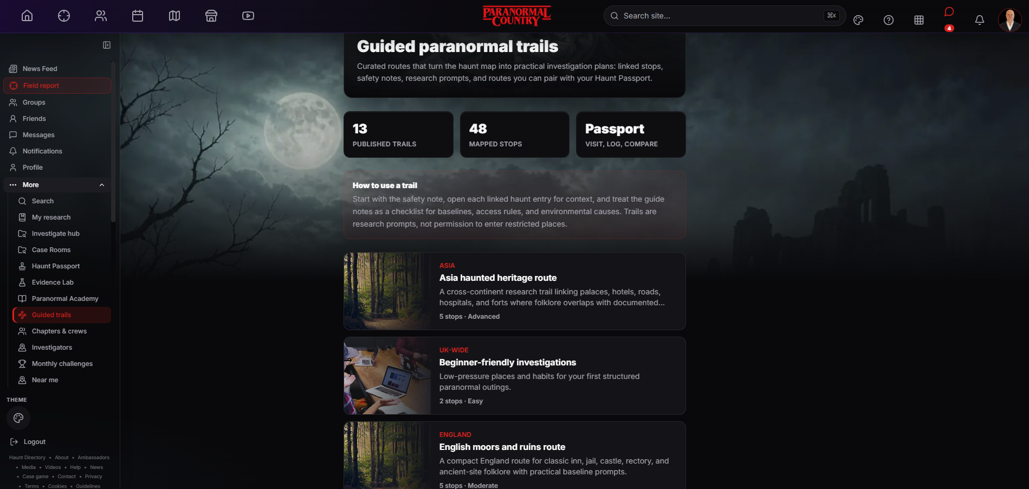
DISCOVER
06
Guided paranormal trails
Curated routes turn individual locations into practical investigation plans.
FEATURE SUMMARY
Trails link several haunt entries into a planned route with safety notes, research prompts and difficulty guidance. Members can pair the routes with their Haunt Passport.
TALKING POINTS
Linked stops create a coherent route
Safety and access notes come first
Routes connect with Haunt Passport
LIVE PLATFORM VIEW · JULY 2026
PARANORMALCOUNTRY.COM
DISCOVER • EXPLORE • INVESTIGATE • BELIEVE
Notes:
Curated routes turn individual locations into practical investigation plans.
Trails link several haunt entries into a planned route with safety notes, research prompts and difficulty guidance. Members can pair the routes with their Haunt Passport.
Talking points:
• Linked stops create a coherent route
• Safety and access notes come first
• Routes connect with Haunt Passport
Presenter guidance:
Rather than showing isolated pins, guided trails help members plan a full outing. The emphasis is on preparation, access rules and sensible research prompts rather than encouraging people to enter unsafe or restricted places.

Slide 7
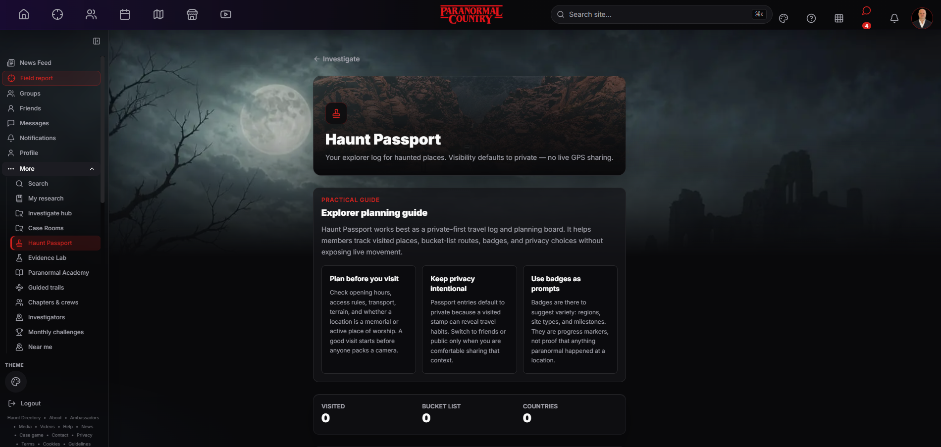
DISCOVER
07
Haunt Passport
A private-first travel log for visited places and future plans.
FEATURE SUMMARY
Haunt Passport records visited locations, bucket-list destinations and milestones. Entries default to private and the feature does not use continuous live GPS sharing.
TALKING POINTS
Visited and bucket-list tracking
Private by default with no live tracking
Badges encourage exploration, not proof
LIVE PLATFORM VIEW · JULY 2026
PARANORMALCOUNTRY.COM
DISCOVER • EXPLORE • INVESTIGATE • BELIEVE
Notes:
A private-first travel log for visited places and future plans.
Haunt Passport records visited locations, bucket-list destinations and milestones. Entries default to private and the feature does not use continuous live GPS sharing.
Talking points:
• Visited and bucket-list tracking
• Private by default with no live tracking
• Badges encourage exploration, not proof
Presenter guidance:
The Passport gives exploration a personal memory and planning layer. It helps members prepare visits and record progress while keeping travel habits private unless they deliberately choose to share them.

Slide 8
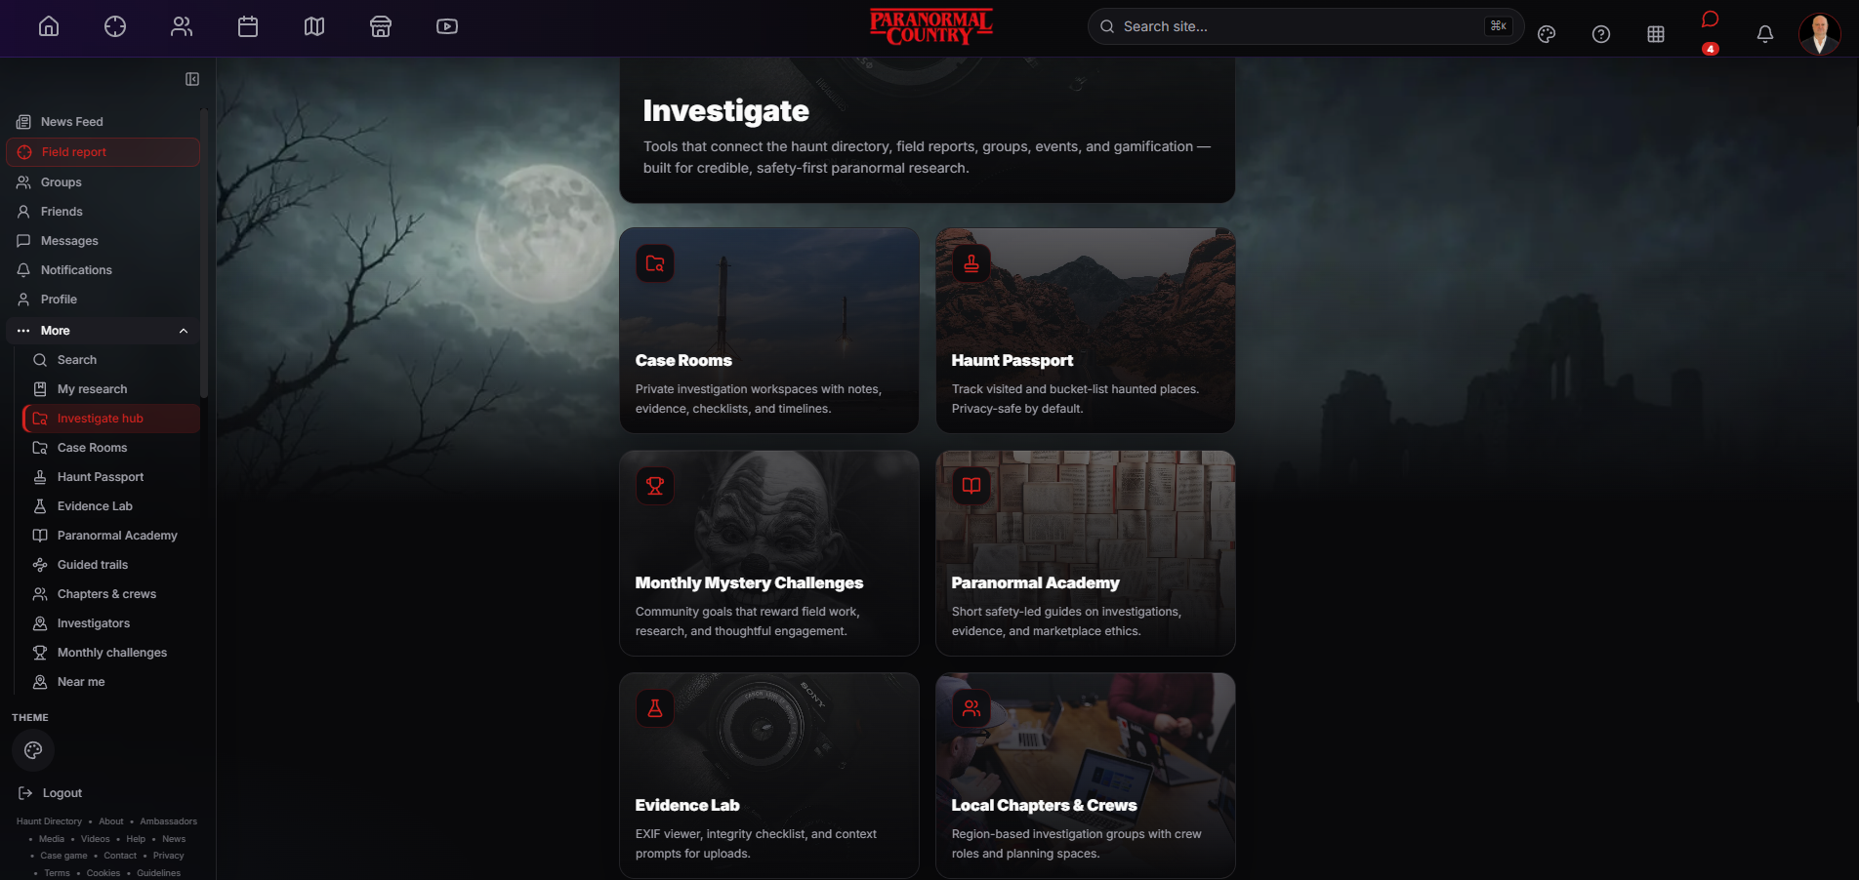
INVESTIGATE
08
Investigation Hub
One doorway to the platform’s research and fieldwork tools.
FEATURE SUMMARY
The hub connects Case Rooms, Haunt Passport, challenges, the Academy, Evidence Lab and local crews. Members can see how separate tools support one investigation workflow.
TALKING POINTS
Central route into specialist tools
Connects fieldwork, learning and cases
Safety-led research remains the focus
LIVE PLATFORM VIEW · JULY 2026
PARANORMALCOUNTRY.COM
INVESTIGATE • EXPLORE • INVESTIGATE • BELIEVE
Notes:
One doorway to the platform’s research and fieldwork tools.
The hub connects Case Rooms, Haunt Passport, challenges, the Academy, Evidence Lab and local crews. Members can see how separate tools support one investigation workflow.
Talking points:
• Central route into specialist tools
• Connects fieldwork, learning and cases
• Safety-led research remains the focus
Presenter guidance:
This screen prevents the research tools from feeling scattered. A member can move from learning and preparation into evidence handling, case organisation and local collaboration from one clear starting point.

Slide 9
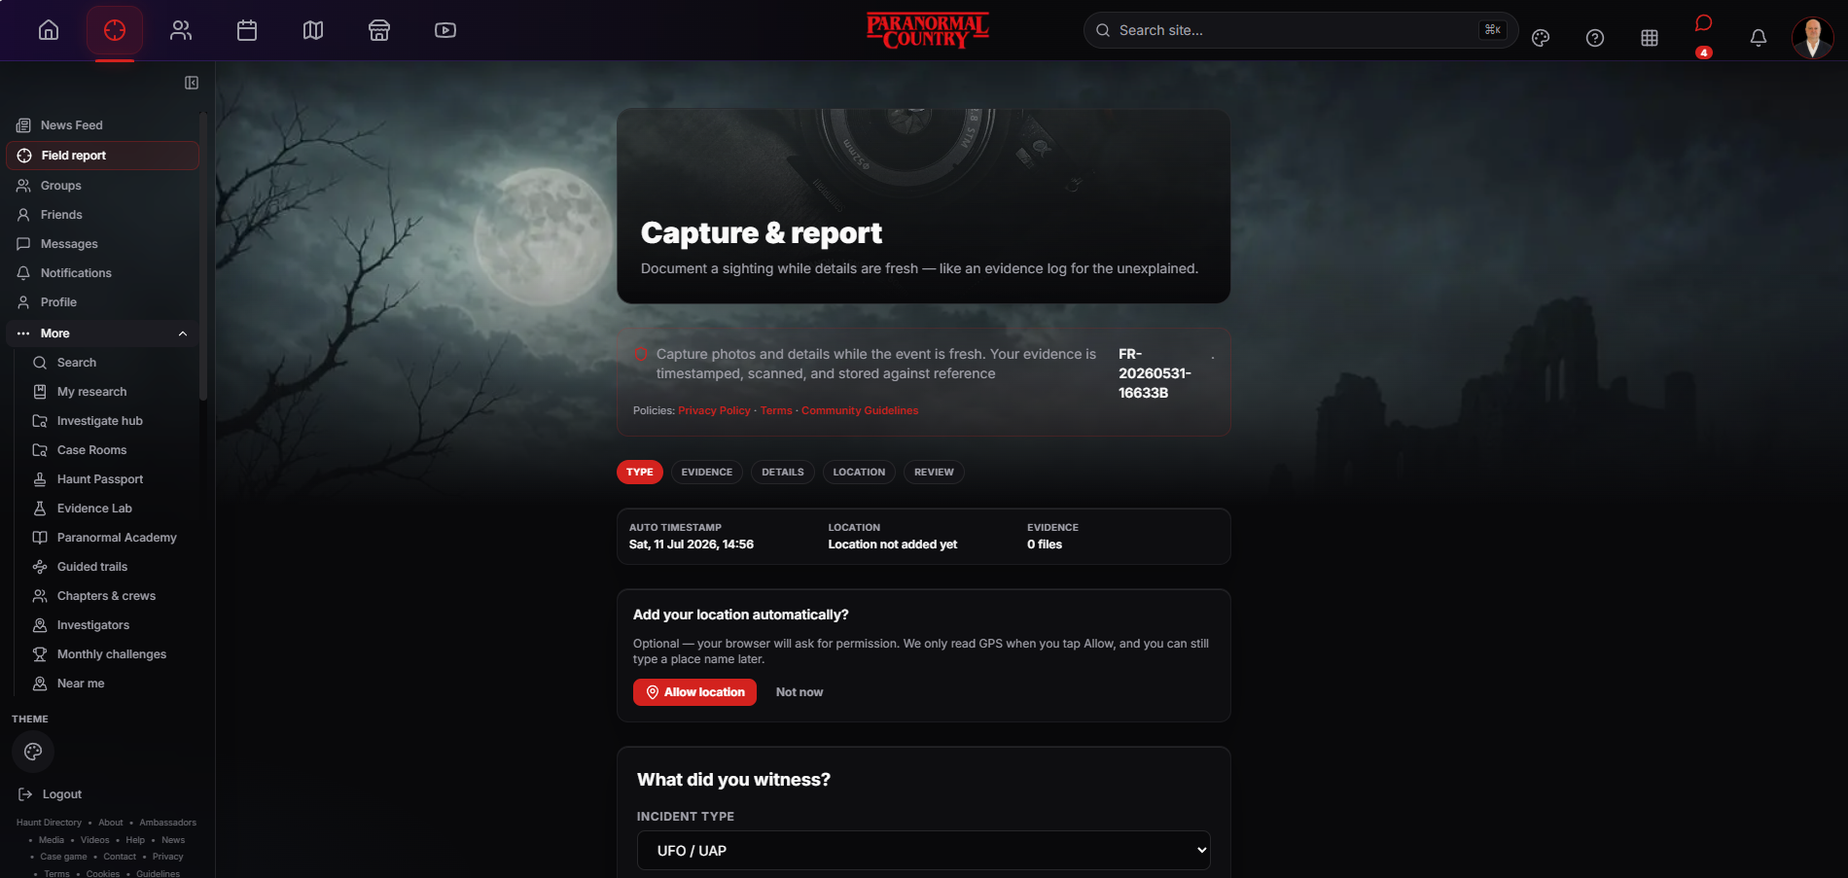
INVESTIGATE
09
Field report wizard
Capture what happened while the details are still fresh.
FEATURE SUMMARY
The structured wizard records incident type, evidence, details, location and review choices. It creates a reference number and makes location permission optional rather than assumed.
TALKING POINTS
Guided, consistent reporting steps
Timestamp and reference for each report
Location remains optional and controlled
LIVE PLATFORM VIEW · JULY 2026
PARANORMALCOUNTRY.COM
INVESTIGATE • EXPLORE • INVESTIGATE • BELIEVE
Notes:
Capture what happened while the details are still fresh.
The structured wizard records incident type, evidence, details, location and review choices. It creates a reference number and makes location permission optional rather than assumed.
Talking points:
• Guided, consistent reporting steps
• Timestamp and reference for each report
• Location remains optional and controlled
Presenter guidance:
The report wizard is designed to preserve context before memory changes. It gives every account a consistent structure without forcing members to surrender precise location information.

Slide 10
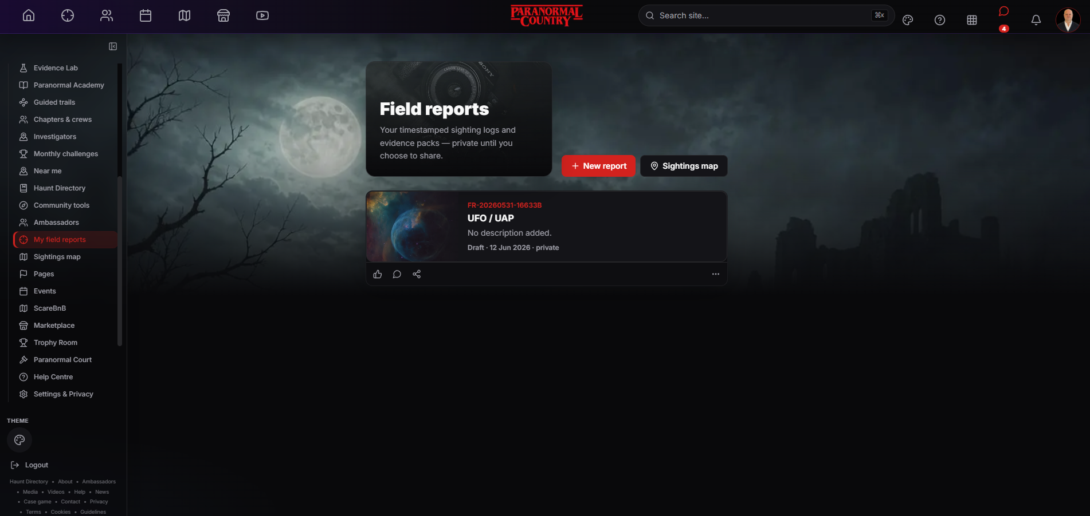
INVESTIGATE
10
My field reports
A private dashboard for reports, drafts and evidence packs.
FEATURE SUMMARY
Members can review their timestamped reports, keep drafts private, start a new report or move directly to the sightings map. Each record keeps its own reference and sharing state.
TALKING POINTS
Reports remain private until shared
Drafts and evidence stay together
Direct link to reporting and map tools
LIVE PLATFORM VIEW · JULY 2026
PARANORMALCOUNTRY.COM
INVESTIGATE • EXPLORE • INVESTIGATE • BELIEVE
Notes:
A private dashboard for reports, drafts and evidence packs.
Members can review their timestamped reports, keep drafts private, start a new report or move directly to the sightings map. Each record keeps its own reference and sharing state.
Talking points:
• Reports remain private until shared
• Drafts and evidence stay together
• Direct link to reporting and map tools
Presenter guidance:
This is the member’s personal reporting archive. It creates continuity between the first capture, later edits and any decision to publish the report to the wider community.

Slide 11
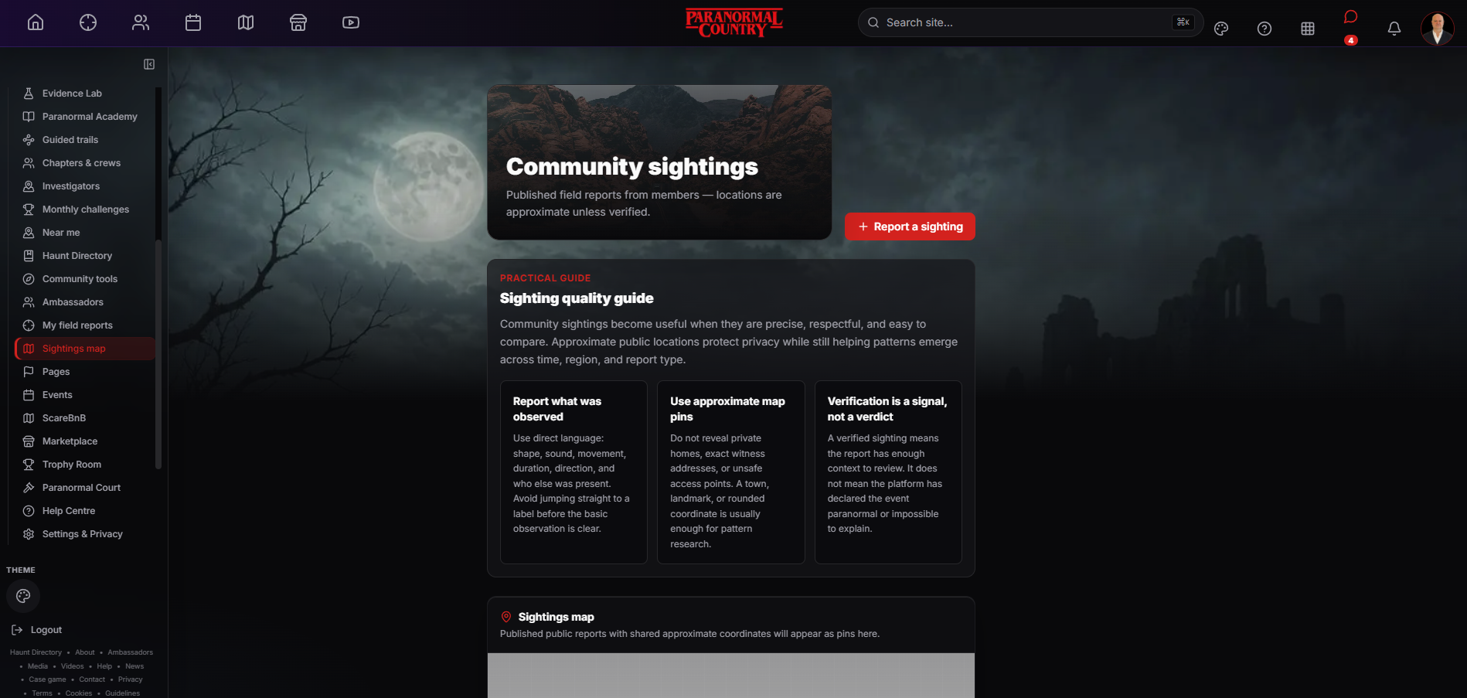
INVESTIGATE
11
Community sightings map
Published reports become geographically useful without exposing exact private locations.
FEATURE SUMMARY
The sightings map displays member reports using approximate locations unless a location has been verified. The guidance separates careful review from declaring an event paranormal.
TALKING POINTS
Approximate pins protect privacy
Reports can be compared by place and type
Verification is a signal, not a verdict
LIVE PLATFORM VIEW · JULY 2026
PARANORMALCOUNTRY.COM
INVESTIGATE • EXPLORE • INVESTIGATE • BELIEVE
Notes:
Published reports become geographically useful without exposing exact private locations.
The sightings map displays member reports using approximate locations unless a location has been verified. The guidance separates careful review from declaring an event paranormal.
Talking points:
• Approximate pins protect privacy
• Reports can be compared by place and type
• Verification is a signal, not a verdict
Presenter guidance:
The map is useful for identifying patterns across time and region. It deliberately avoids presenting verification as proof; it means the report contains enough context for meaningful review.

Slide 12
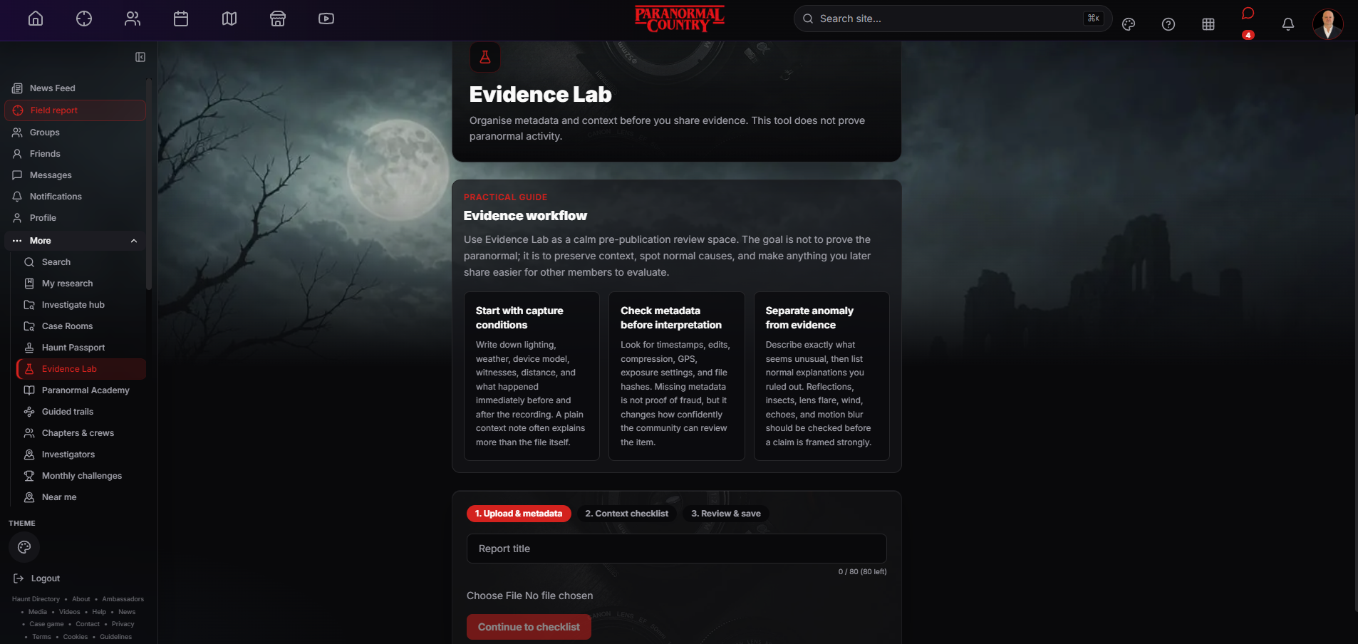
INVESTIGATE
12
Evidence Lab
A calm pre-publication check for metadata, context and normal causes.
FEATURE SUMMARY
Evidence Lab helps members record capture conditions, examine metadata and distinguish an unusual observation from evidence. It organises context; it does not prove paranormal activity.
TALKING POINTS
Review metadata before interpretation
Record lighting, weather and witnesses
Check ordinary explanations first
LIVE PLATFORM VIEW · JULY 2026
PARANORMALCOUNTRY.COM
INVESTIGATE • EXPLORE • INVESTIGATE • BELIEVE
Notes:
A calm pre-publication check for metadata, context and normal causes.
Evidence Lab helps members record capture conditions, examine metadata and distinguish an unusual observation from evidence. It organises context; it does not prove paranormal activity.
Talking points:
• Review metadata before interpretation
• Record lighting, weather and witnesses
• Check ordinary explanations first
Presenter guidance:
This feature supports better evidence habits. Members are prompted to preserve originals, record the surrounding conditions and examine normal explanations before framing a strong claim.

Slide 13
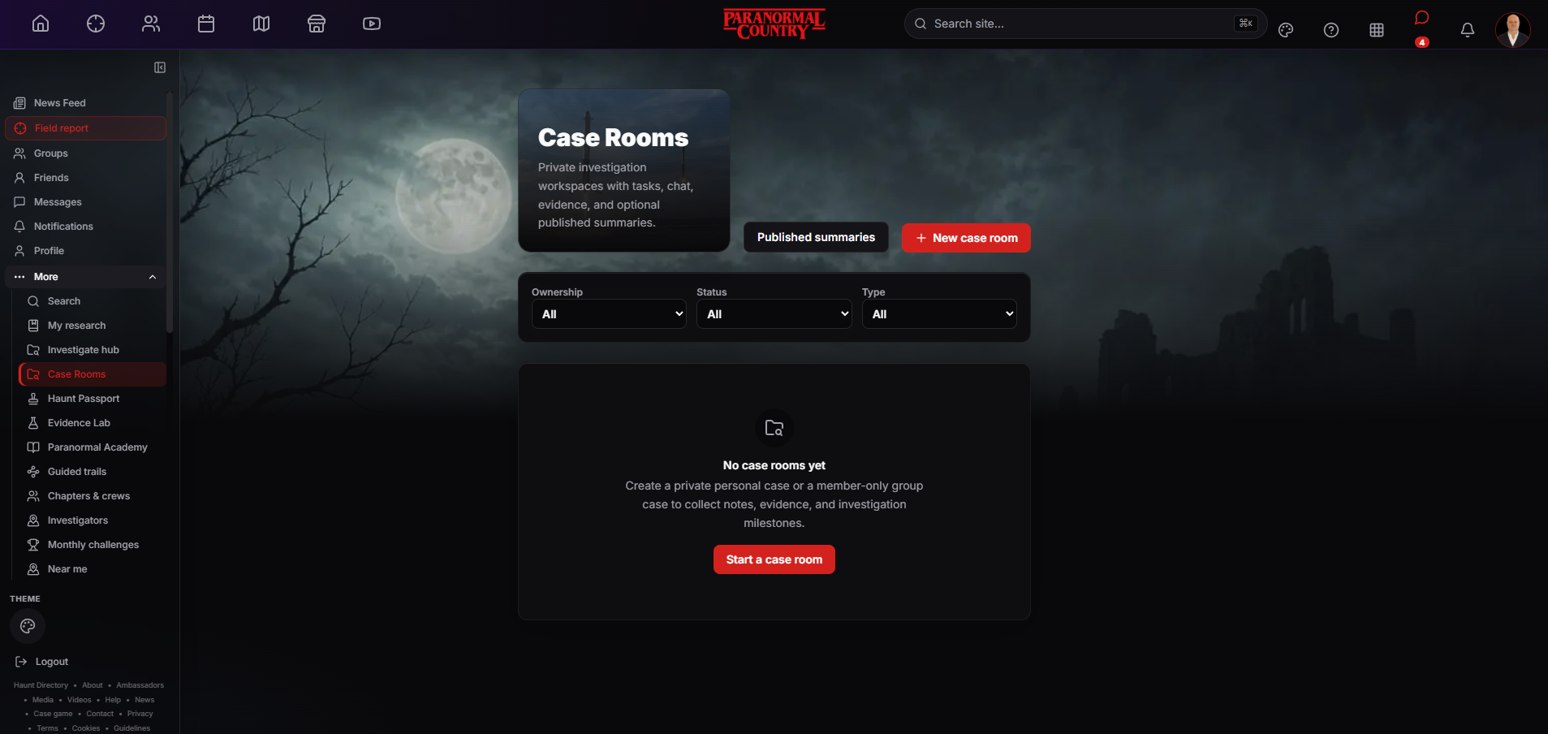
INVESTIGATE
13
Case Rooms
Private workspaces for structured investigations and collaboration.
FEATURE SUMMARY
Case Rooms bring tasks, chat, evidence, notes and milestones into one private workspace. Teams can publish a summary later without exposing their underlying private material.
TALKING POINTS
Private personal or group cases
Evidence, tasks and chat stay together
Public summaries are optional
LIVE PLATFORM VIEW · JULY 2026
PARANORMALCOUNTRY.COM
INVESTIGATE • EXPLORE • INVESTIGATE • BELIEVE
Notes:
Private workspaces for structured investigations and collaboration.
Case Rooms bring tasks, chat, evidence, notes and milestones into one private workspace. Teams can publish a summary later without exposing their underlying private material.
Talking points:
• Private personal or group cases
• Evidence, tasks and chat stay together
• Public summaries are optional
Presenter guidance:
Case Rooms are where a report becomes an organised investigation. Contributors can coordinate without mixing unfinished case material into the public feed, then decide whether a carefully written summary should be published.

Slide 14
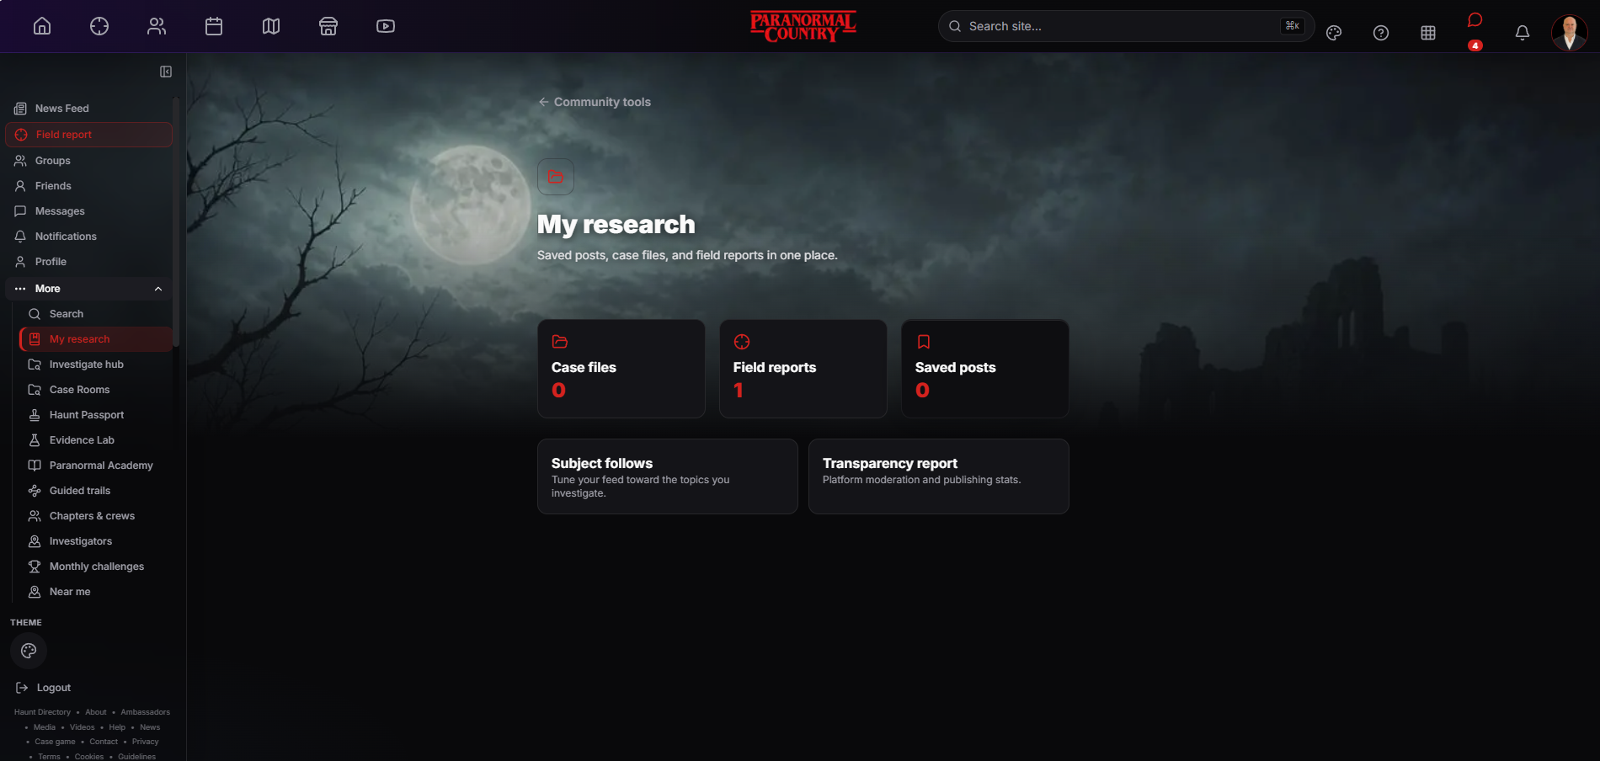
INVESTIGATE
14
My research
Saved posts, case files and field reports in one personal workspace.
FEATURE SUMMARY
My Research gives members a private overview of their cases, reports and saved posts. Topic follows help tune future discovery, while the transparency report remains easy to reach.
TALKING POINTS
One view of personal research material
Topic follows improve relevant discovery
Transparency information stays visible
LIVE PLATFORM VIEW · JULY 2026
PARANORMALCOUNTRY.COM
INVESTIGATE • EXPLORE • INVESTIGATE • BELIEVE
Notes:
Saved posts, case files and field reports in one personal workspace.
My Research gives members a private overview of their cases, reports and saved posts. Topic follows help tune future discovery, while the transparency report remains easy to reach.
Talking points:
• One view of personal research material
• Topic follows improve relevant discovery
• Transparency information stays visible
Presenter guidance:
This is the member’s research home rather than another public profile. It reduces the need to search through the feed for useful material and keeps ongoing work organised around the member’s own interests.

Slide 15
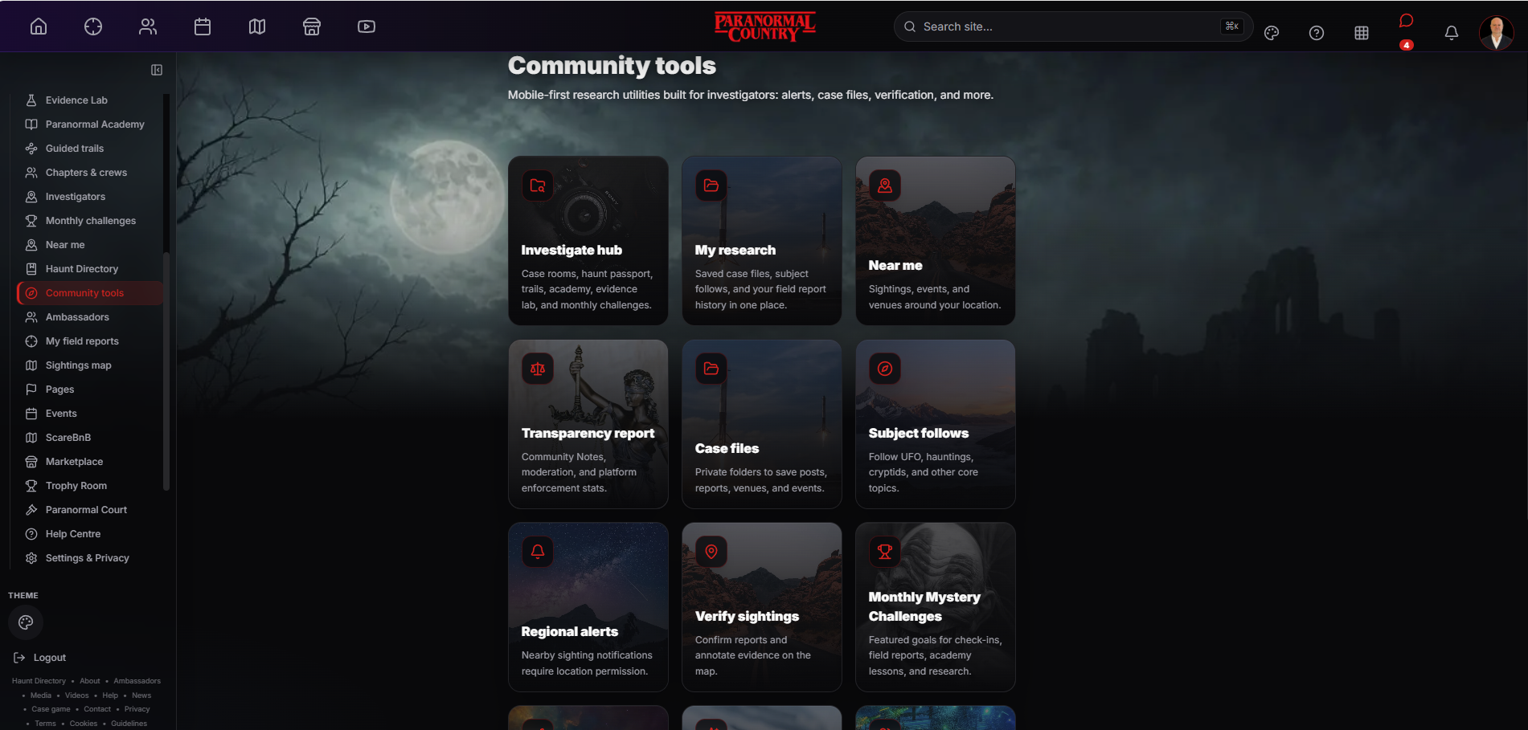
INVESTIGATE
15
Community tools
A mobile-first collection of utilities for research and participation.
FEATURE SUMMARY
Community Tools brings research, alerts, verification, topic follows, case files and monthly challenges together. It shows the practical side of the network beyond posting and commenting.
TALKING POINTS
Research tools are grouped by purpose
Regional alerts support local discovery
Challenges connect activity with progress
LIVE PLATFORM VIEW · JULY 2026
PARANORMALCOUNTRY.COM
INVESTIGATE • EXPLORE • INVESTIGATE • BELIEVE
Notes:
A mobile-first collection of utilities for research and participation.
Community Tools brings research, alerts, verification, topic follows, case files and monthly challenges together. It shows the practical side of the network beyond posting and commenting.
Talking points:
• Research tools are grouped by purpose
• Regional alerts support local discovery
• Challenges connect activity with progress
Presenter guidance:
This screen demonstrates that Paranormal Country is more than a conventional social feed. Members can move directly into research, location-based discovery, verification and structured participation.

Slide 16
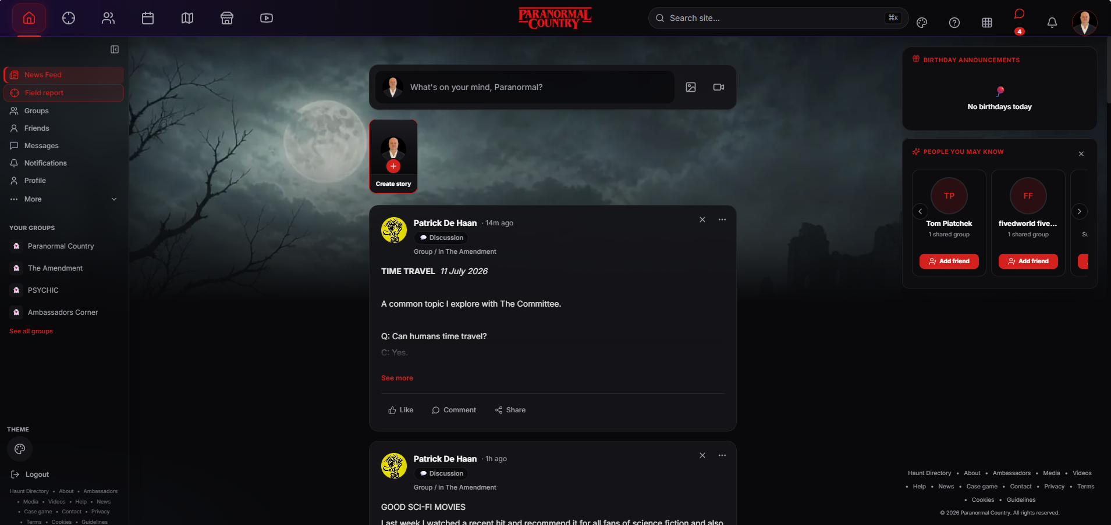
COMMUNITY
16
News Feed
The main social space for experiences, evidence, discussion and discovery.
FEATURE SUMMARY
Members can create posts and stories, respond through comments and reactions, and share useful material. Friend suggestions, groups and birthdays make the feed feel connected to real people.
TALKING POINTS
Posts, stories and media in one feed
Comments, reactions and sharing
Groups and people discovery alongside content
LIVE PLATFORM VIEW · JULY 2026
PARANORMALCOUNTRY.COM
COMMUNITY • EXPLORE • INVESTIGATE • BELIEVE
Notes:
The main social space for experiences, evidence, discussion and discovery.
Members can create posts and stories, respond through comments and reactions, and share useful material. Friend suggestions, groups and birthdays make the feed feel connected to real people.
Talking points:
• Posts, stories and media in one feed
• Comments, reactions and sharing
• Groups and people discovery alongside content
Presenter guidance:
The feed is the everyday home of the network. It supports ordinary social interaction while labels and specialist tools help distinguish discussion, theory, evidence and entertainment.

Slide 17
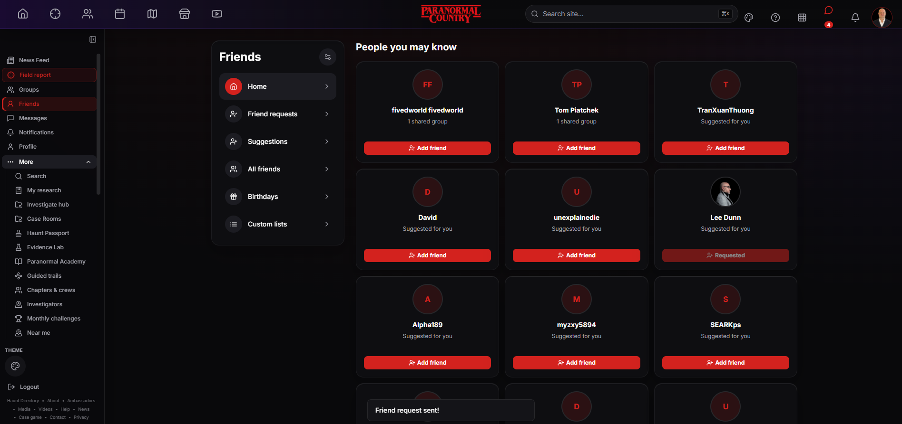
COMMUNITY
17
Friends Hub
Manage requests, suggestions, lists and birthdays without cluttering the feed.
FEATURE SUMMARY
The Friends Hub separates relationship management from content browsing. Members can review requests, discover shared connections and organise people into custom lists.
TALKING POINTS
Requests and suggestions in one place
Shared groups improve recommendations
Custom lists support a manageable network
LIVE PLATFORM VIEW · JULY 2026
PARANORMALCOUNTRY.COM
COMMUNITY • EXPLORE • INVESTIGATE • BELIEVE
Notes:
Manage requests, suggestions, lists and birthdays without cluttering the feed.
The Friends Hub separates relationship management from content browsing. Members can review requests, discover shared connections and organise people into custom lists.
Talking points:
• Requests and suggestions in one place
• Shared groups improve recommendations
• Custom lists support a manageable network
Presenter guidance:
This feature makes connections intentional. It gives members a clear way to decide who enters their circle and helps them organise a growing network without losing control.

Slide 18
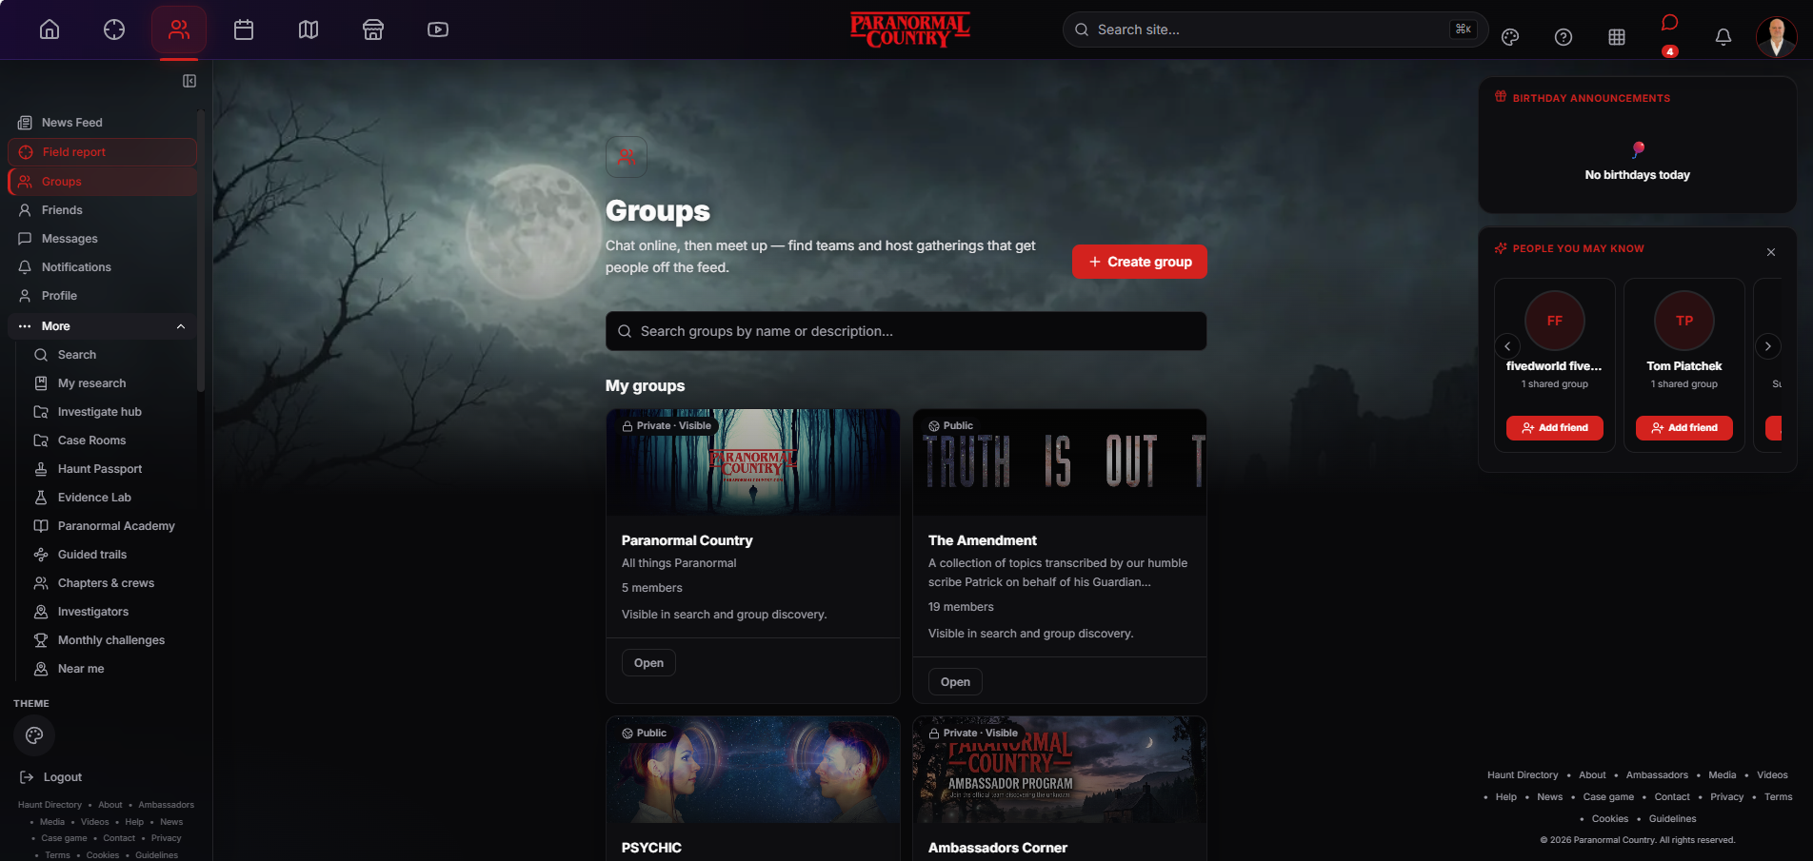
COMMUNITY
18
Groups
Public and private spaces for shared interests, teams and local activity.
FEATURE SUMMARY
Members can search, create and join topic groups with clear visibility settings. Groups can support discussion online and become the base for real-world collaboration.
TALKING POINTS
Public and private visibility options
Topic and regional communities
Designed to support online and offline activity
LIVE PLATFORM VIEW · JULY 2026
PARANORMALCOUNTRY.COM
COMMUNITY • EXPLORE • INVESTIGATE • BELIEVE
Notes:
Public and private spaces for shared interests, teams and local activity.
Members can search, create and join topic groups with clear visibility settings. Groups can support discussion online and become the base for real-world collaboration.
Talking points:
• Public and private visibility options
• Topic and regional communities
• Designed to support online and offline activity
Presenter guidance:
Groups give specialist conversations a home outside the main feed. They can remain broad topic communities or develop into structured investigation teams and regional chapters.

Slide 19
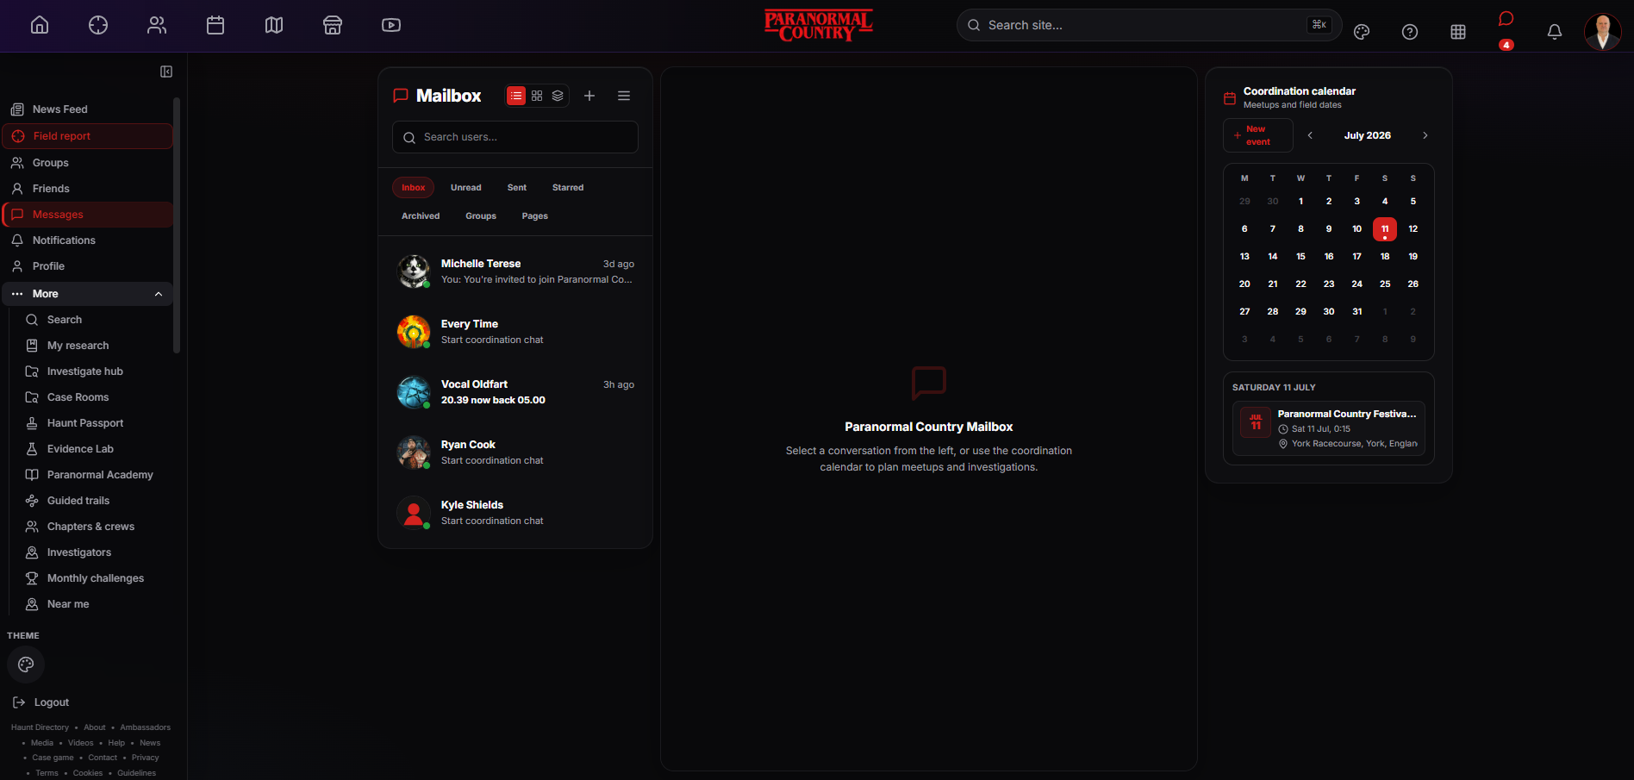
COMMUNITY
19
Messages and coordination
Private conversation and practical planning share the same workspace.
FEATURE SUMMARY
The Mailbox organises conversations across people, groups and Pages. A coordination calendar helps members turn conversations into meetups, events and investigation plans.
TALKING POINTS
Organised inbox with useful filters
People, groups and Pages can be separated
Calendar links chat with real plans
LIVE PLATFORM VIEW · JULY 2026
PARANORMALCOUNTRY.COM
COMMUNITY • EXPLORE • INVESTIGATE • BELIEVE
Notes:
Private conversation and practical planning share the same workspace.
The Mailbox organises conversations across people, groups and Pages. A coordination calendar helps members turn conversations into meetups, events and investigation plans.
Talking points:
• Organised inbox with useful filters
• People, groups and Pages can be separated
• Calendar links chat with real plans
Presenter guidance:
Messaging is not treated as an isolated chat feature. The coordination calendar makes it easier to move from discussion to a scheduled event while keeping the planning context nearby.

Slide 20
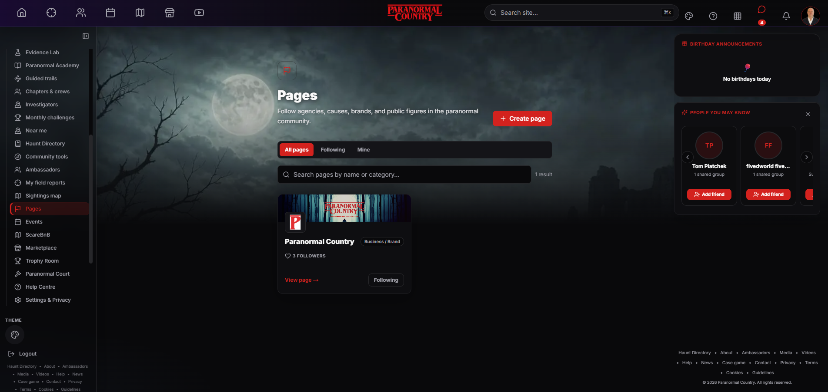
COMMUNITY
20
Pages
Follow organisations, causes, brands and public figures in the paranormal community.
FEATURE SUMMARY
Pages give organisations and creators a public presence separate from personal profiles. Members can search, follow and return to trusted sources more easily.
TALKING POINTS
Public presence separate from a profile
Search and category discovery
Followers build an ongoing audience
LIVE PLATFORM VIEW · JULY 2026
PARANORMALCOUNTRY.COM
COMMUNITY • EXPLORE • INVESTIGATE • BELIEVE
Notes:
Follow organisations, causes, brands and public figures in the paranormal community.
Pages give organisations and creators a public presence separate from personal profiles. Members can search, follow and return to trusted sources more easily.
Talking points:
• Public presence separate from a profile
• Search and category discovery
• Followers build an ongoing audience
Presenter guidance:
Pages are designed for identities that represent more than one individual. They allow brands, causes and public-facing creators to publish consistently without turning a personal account into a business profile.

Slide 21
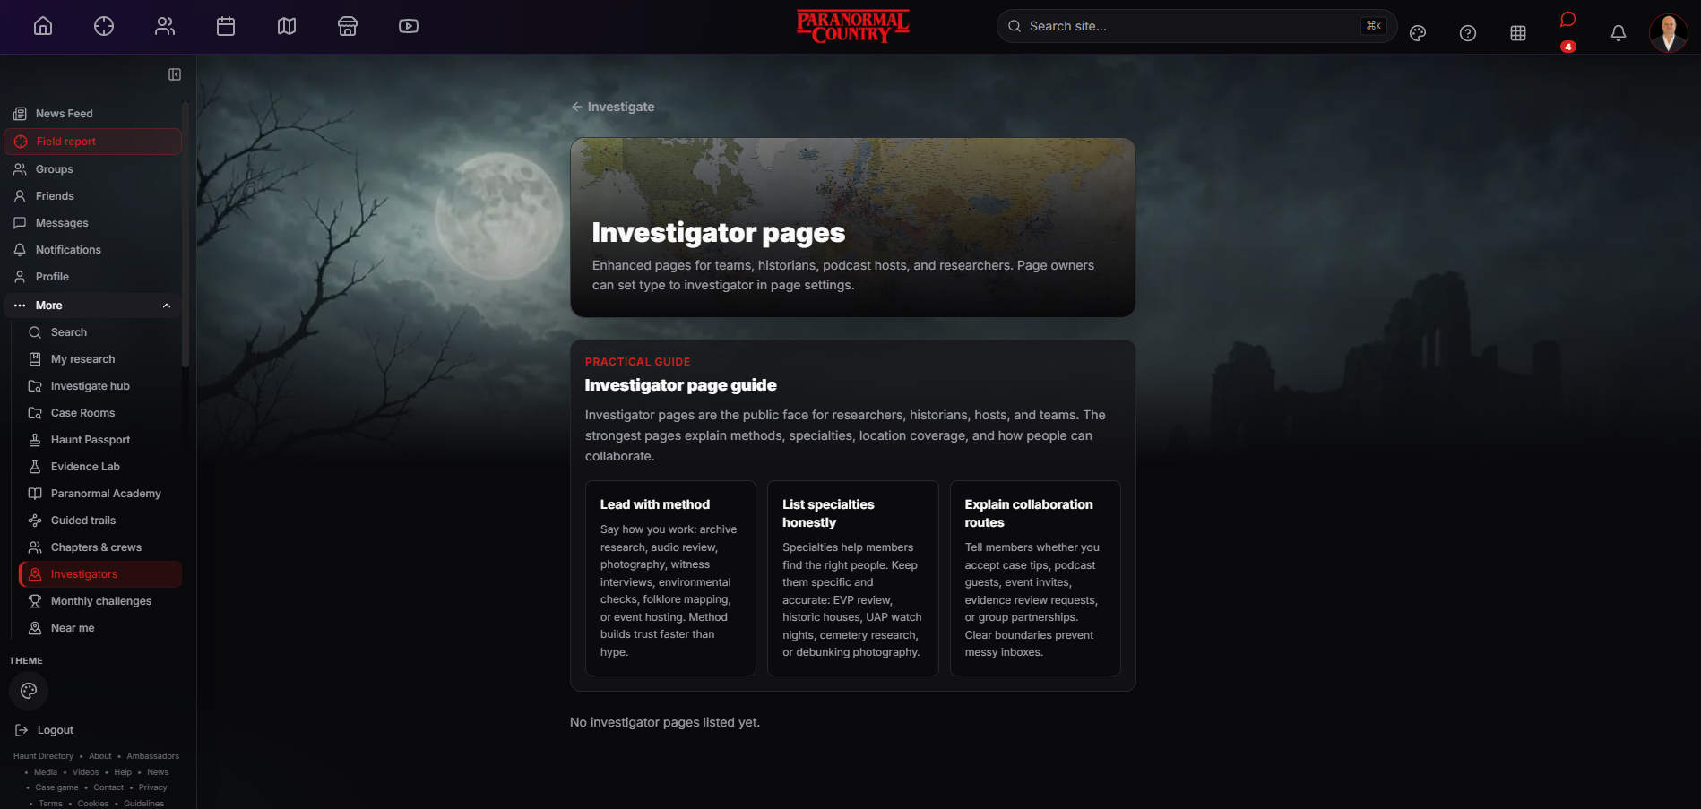
COMMUNITY
21
Investigator pages
Specialist public pages for researchers, teams, historians and hosts.
FEATURE SUMMARY
Investigator pages help teams explain their methods, specialties, location coverage and collaboration routes. Clear boundaries make it easier for members to approach the right people.
TALKING POINTS
Methods and specialties are made visible
Suitable for teams, hosts and researchers
Collaboration expectations stay clear
LIVE PLATFORM VIEW · JULY 2026
PARANORMALCOUNTRY.COM
COMMUNITY • EXPLORE • INVESTIGATE • BELIEVE
Notes:
Specialist public pages for researchers, teams, historians and hosts.
Investigator pages help teams explain their methods, specialties, location coverage and collaboration routes. Clear boundaries make it easier for members to approach the right people.
Talking points:
• Methods and specialties are made visible
• Suitable for teams, hosts and researchers
• Collaboration expectations stay clear
Presenter guidance:
These pages help responsible investigators stand out through method rather than hype. Members can understand what a team actually does and how to collaborate before making contact.

Slide 22
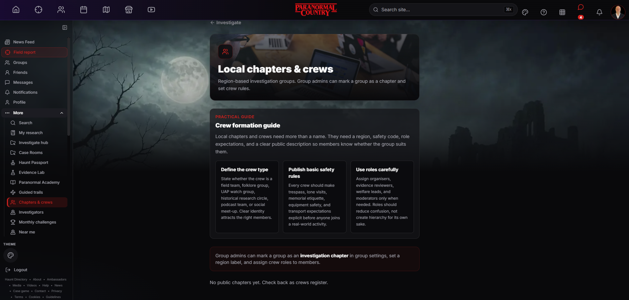
COMMUNITY
22
Local chapters and crews
Regional investigation groups with defined roles and safety expectations.
FEATURE SUMMARY
A group can become an investigation chapter with a region, crew rules and assigned responsibilities. The guide encourages clear identity, public safety rules and careful use of roles.
TALKING POINTS
Regional identity and crew purpose
Safety rules are published clearly
Roles organise work without creating hierarchy
LIVE PLATFORM VIEW · JULY 2026
PARANORMALCOUNTRY.COM
COMMUNITY • EXPLORE • INVESTIGATE • BELIEVE
Notes:
Regional investigation groups with defined roles and safety expectations.
A group can become an investigation chapter with a region, crew rules and assigned responsibilities. The guide encourages clear identity, public safety rules and careful use of roles.
Talking points:
• Regional identity and crew purpose
• Safety rules are published clearly
• Roles organise work without creating hierarchy
Presenter guidance:
Chapters are the bridge between online community and organised local activity. Their structure helps members understand who is responsible for planning, evidence review, welfare and moderation.

Slide 23
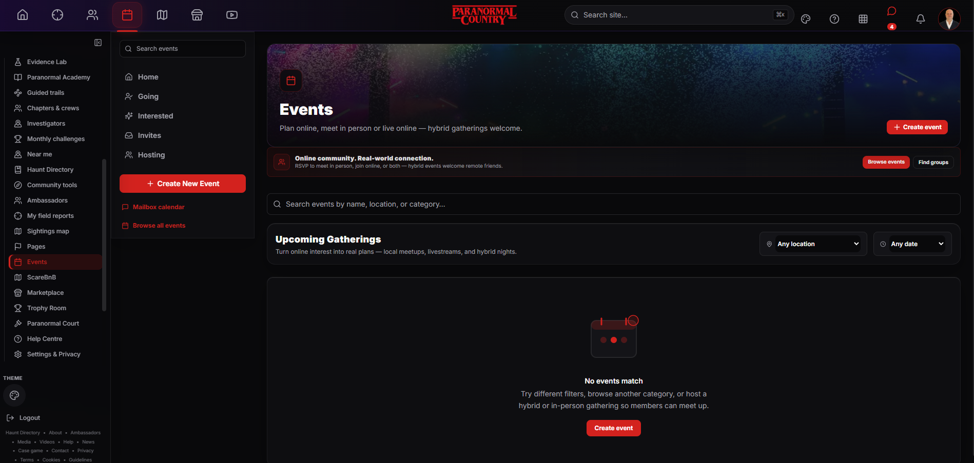
MEET
23
Events Hub
Plan investigations, meetups, livestreams and hybrid gatherings.
FEATURE SUMMARY
The Events Hub supports discovery, hosting, invitations and attendance choices. Members can search by location or date and take online discussion into a planned gathering.
TALKING POINTS
Online, in-person and hybrid events
Hosting, invites and attendance tools
Search by place, date or category
LIVE PLATFORM VIEW · JULY 2026
PARANORMALCOUNTRY.COM
MEET • EXPLORE • INVESTIGATE • BELIEVE
Notes:
Plan investigations, meetups, livestreams and hybrid gatherings.
The Events Hub supports discovery, hosting, invitations and attendance choices. Members can search by location or date and take online discussion into a planned gathering.
Talking points:
• Online, in-person and hybrid events
• Hosting, invites and attendance tools
• Search by place, date or category
Presenter guidance:
Events make the community practical. The same system can support a local investigation, a public meetup or a remote livestream without treating online members as an afterthought.

Slide 24
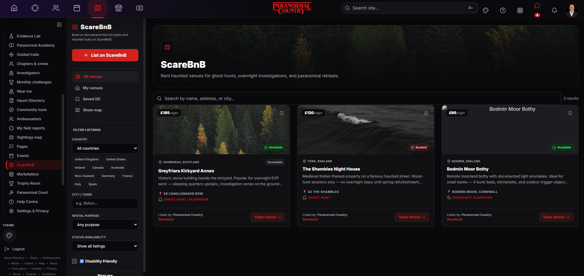
MEET
24
ScareBnB
Browse investigation-friendly venues, overnight stays and paranormal retreats.
FEATURE SUMMARY
ScareBnB helps members find venues by country, town, purpose, availability and accessibility. Hosts can list suitable locations while visitors compare practical information.
TALKING POINTS
Search venues by purpose and location
Availability, price and access are visible
Hosts can list investigation-friendly places
LIVE PLATFORM VIEW · JULY 2026
PARANORMALCOUNTRY.COM
MEET • EXPLORE • INVESTIGATE • BELIEVE
Notes:
Browse investigation-friendly venues, overnight stays and paranormal retreats.
ScareBnB helps members find venues by country, town, purpose, availability and accessibility. Hosts can list suitable locations while visitors compare practical information.
Talking points:
• Search venues by purpose and location
• Availability, price and access are visible
• Hosts can list investigation-friendly places
Presenter guidance:
ScareBnB connects venue discovery with the needs of paranormal visitors. The aim is to make access, availability and suitability visible before a group commits to an investigation or overnight stay.

Slide 25
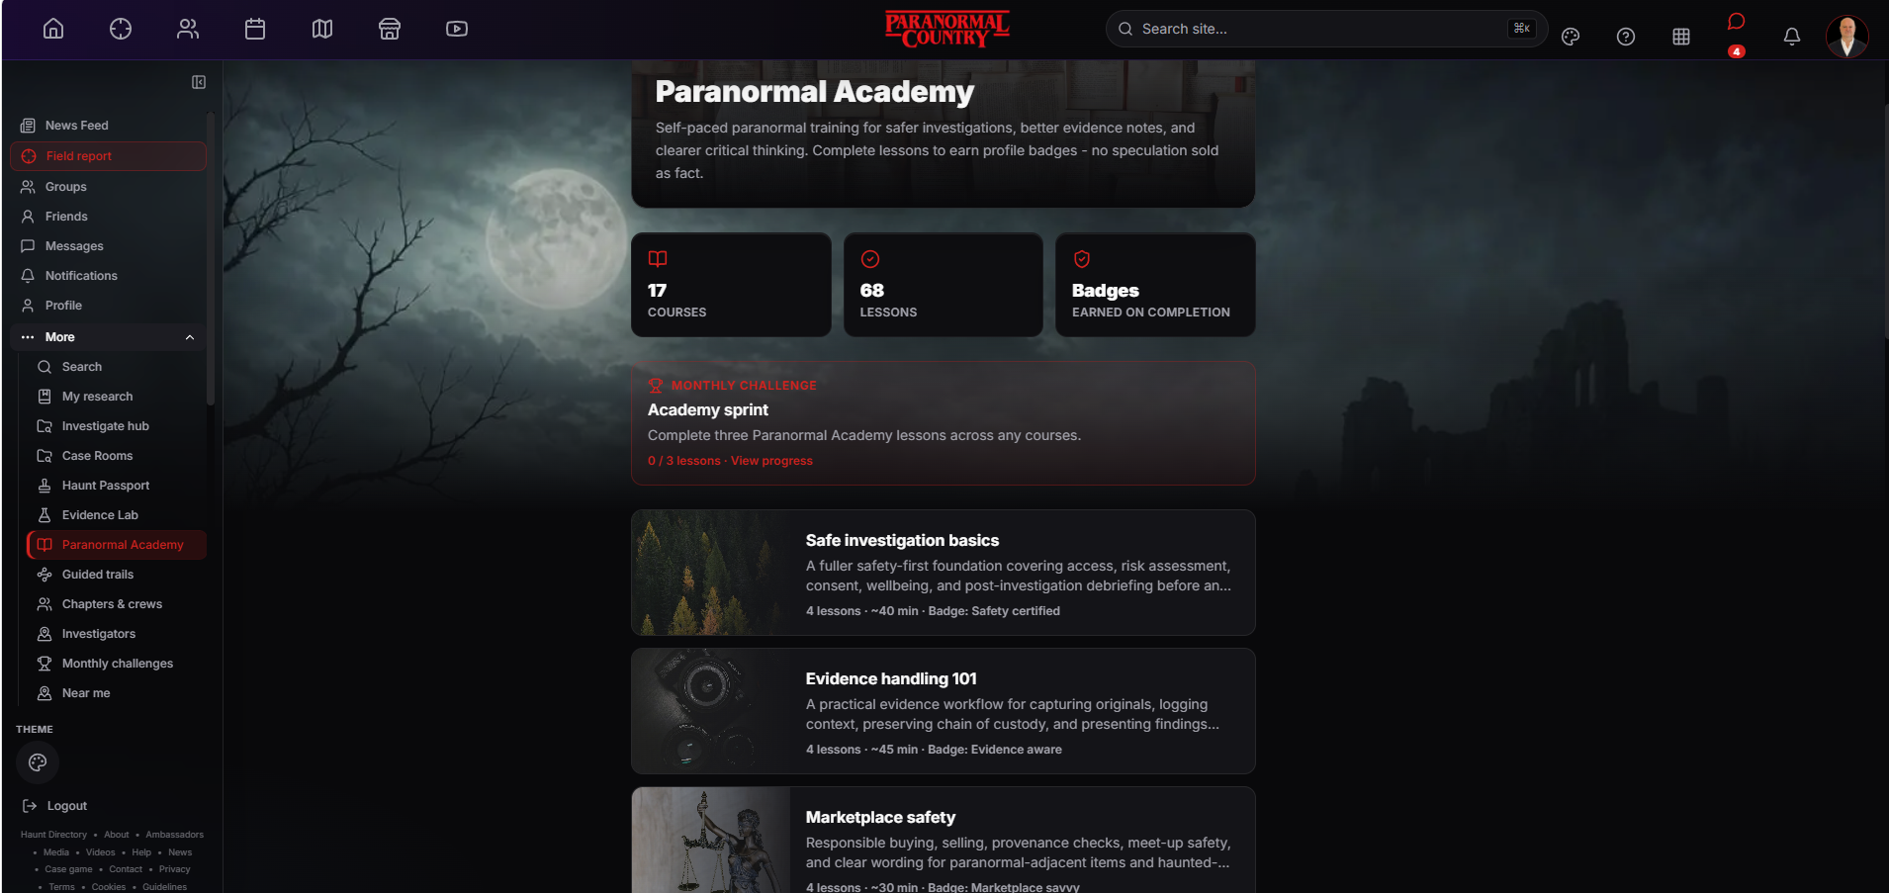
LEARN
25
Paranormal Academy
Self-paced training for safer investigations and clearer critical thinking.
FEATURE SUMMARY
The Academy offers short courses and lessons covering investigation safety, evidence handling and marketplace awareness. Badges recognise completion without presenting speculation as fact.
TALKING POINTS
Short self-paced courses and lessons
Safety and evidence handling lead the syllabus
Completion badges show learning progress
LIVE PLATFORM VIEW · JULY 2026
PARANORMALCOUNTRY.COM
LEARN • EXPLORE • INVESTIGATE • BELIEVE
Notes:
Self-paced training for safer investigations and clearer critical thinking.
The Academy offers short courses and lessons covering investigation safety, evidence handling and marketplace awareness. Badges recognise completion without presenting speculation as fact.
Talking points:
• Short self-paced courses and lessons
• Safety and evidence handling lead the syllabus
• Completion badges show learning progress
Presenter guidance:
The Academy helps establish shared standards across the community. Members can learn practical habits before joining fieldwork, handling evidence or trading through the marketplace.

Slide 26
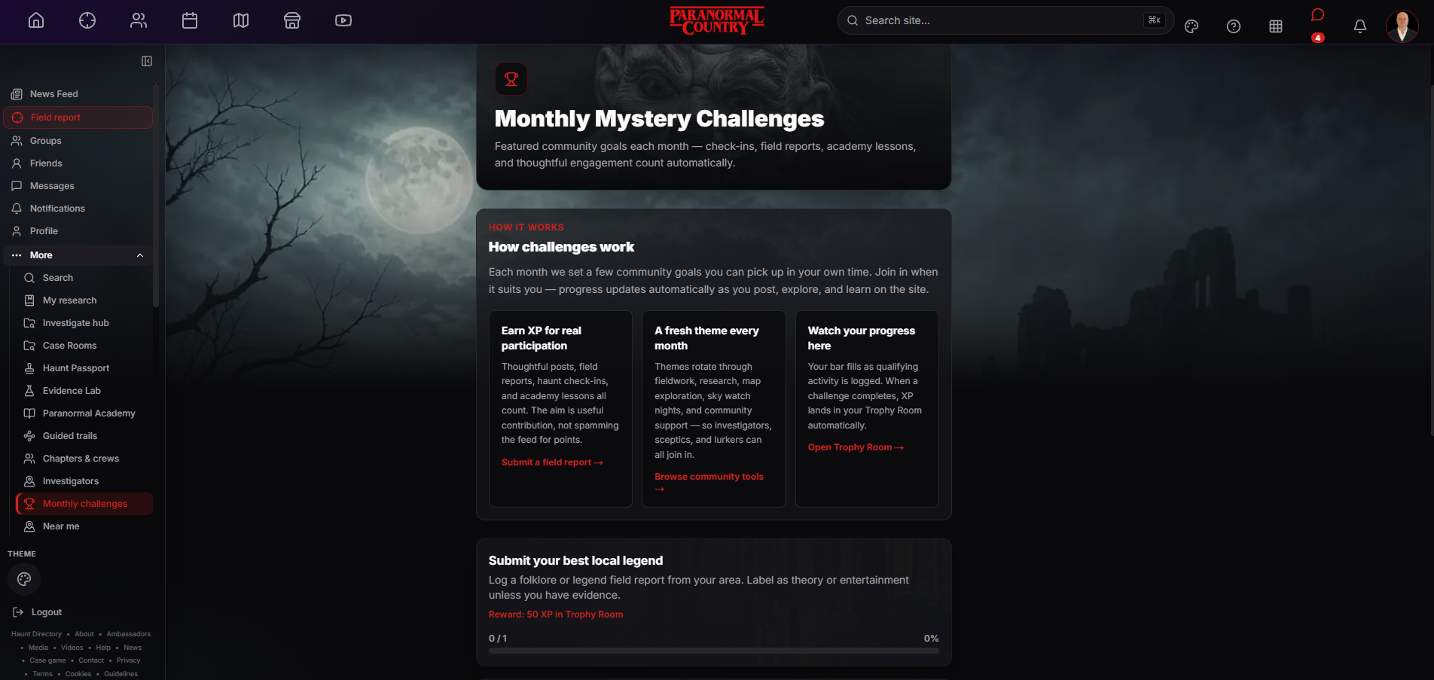
LEARN
26
Monthly Mystery Challenges
Rotating community goals reward useful participation rather than empty activity.
FEATURE SUMMARY
Challenges connect field reports, research, check-ins and Academy lessons to automatic progress. Themes change monthly so different interests and types of contribution can take part.
TALKING POINTS
Progress updates automatically
Themes rotate across research and fieldwork
XP rewards genuine participation
LIVE PLATFORM VIEW · JULY 2026
PARANORMALCOUNTRY.COM
LEARN • EXPLORE • INVESTIGATE • BELIEVE
Notes:
Rotating community goals reward useful participation rather than empty activity.
Challenges connect field reports, research, check-ins and Academy lessons to automatic progress. Themes change monthly so different interests and types of contribution can take part.
Talking points:
• Progress updates automatically
• Themes rotate across research and fieldwork
• XP rewards genuine participation
Presenter guidance:
Challenges give members a reason to explore parts of the platform they might otherwise miss. The design rewards useful contributions and learning rather than encouraging people to spam the feed for points.

Slide 27
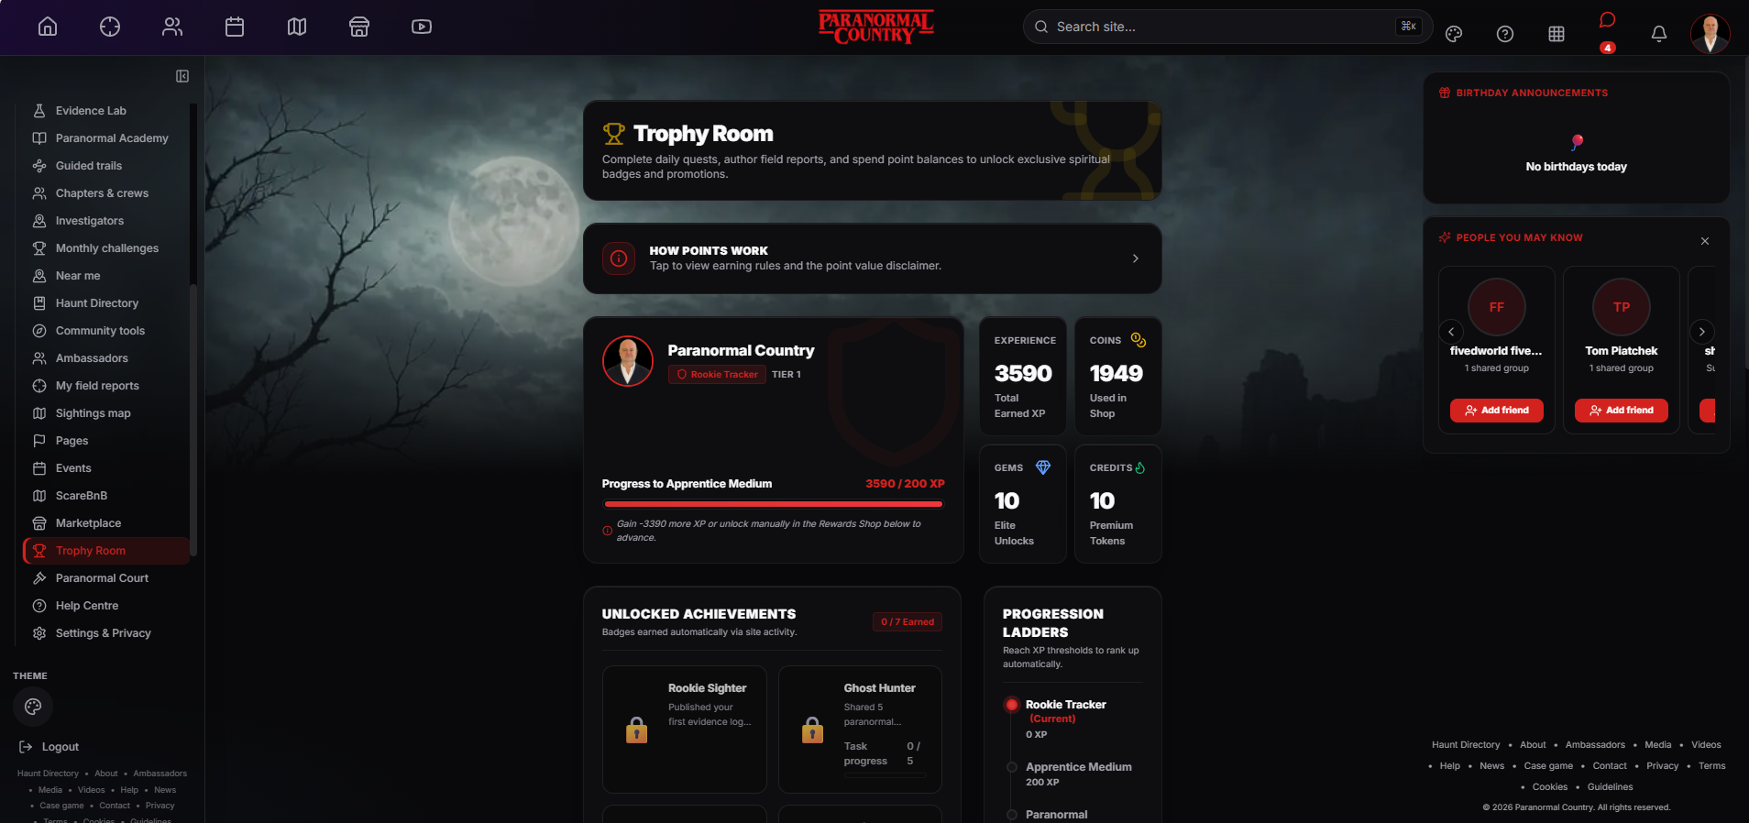
LEARN
27
Trophy Room
A visible home for XP, achievements, badges and progression.
FEATURE SUMMARY
The Trophy Room shows experience, coins, unlocks, achievements and rank progression. Members can understand how activity is recognised and what remains to be completed.
TALKING POINTS
XP and rank progression are transparent
Achievements reflect specific activities
Separate balances have clear purposes
LIVE PLATFORM VIEW · JULY 2026
PARANORMALCOUNTRY.COM
LEARN • EXPLORE • INVESTIGATE • BELIEVE
Notes:
A visible home for XP, achievements, badges and progression.
The Trophy Room shows experience, coins, unlocks, achievements and rank progression. Members can understand how activity is recognised and what remains to be completed.
Talking points:
• XP and rank progression are transparent
• Achievements reflect specific activities
• Separate balances have clear purposes
Presenter guidance:
This feature makes recognition visible without confusing it with evidence quality or authority. It celebrates participation and completed tasks while keeping progression rules accessible.

Slide 28
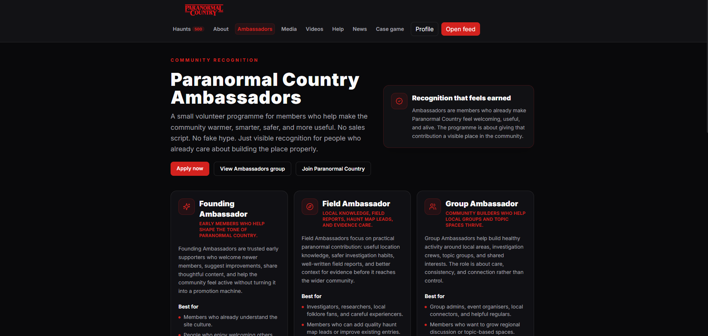
LEARN
28
Paranormal Country Ambassadors
Visible recognition for members who already help the community work well.
FEATURE SUMMARY
The volunteer programme recognises Founding, Field and Group Ambassadors. It focuses on welcome, useful contributions, safer practice and healthy local or topic communities.
TALKING POINTS
Three roles recognise different contributions
The programme is voluntary, not a sales script
Recognition is based on useful community behaviour
LIVE PLATFORM VIEW · JULY 2026
PARANORMALCOUNTRY.COM
LEARN • EXPLORE • INVESTIGATE • BELIEVE
Notes:
Visible recognition for members who already help the community work well.
The volunteer programme recognises Founding, Field and Group Ambassadors. It focuses on welcome, useful contributions, safer practice and healthy local or topic communities.
Talking points:
• Three roles recognise different contributions
• The programme is voluntary, not a sales script
• Recognition is based on useful community behaviour
Presenter guidance:
Ambassadors are not promoters with a script. The programme gives visible credit to members who help with community culture, responsible fieldwork and well-run groups.

Slide 29
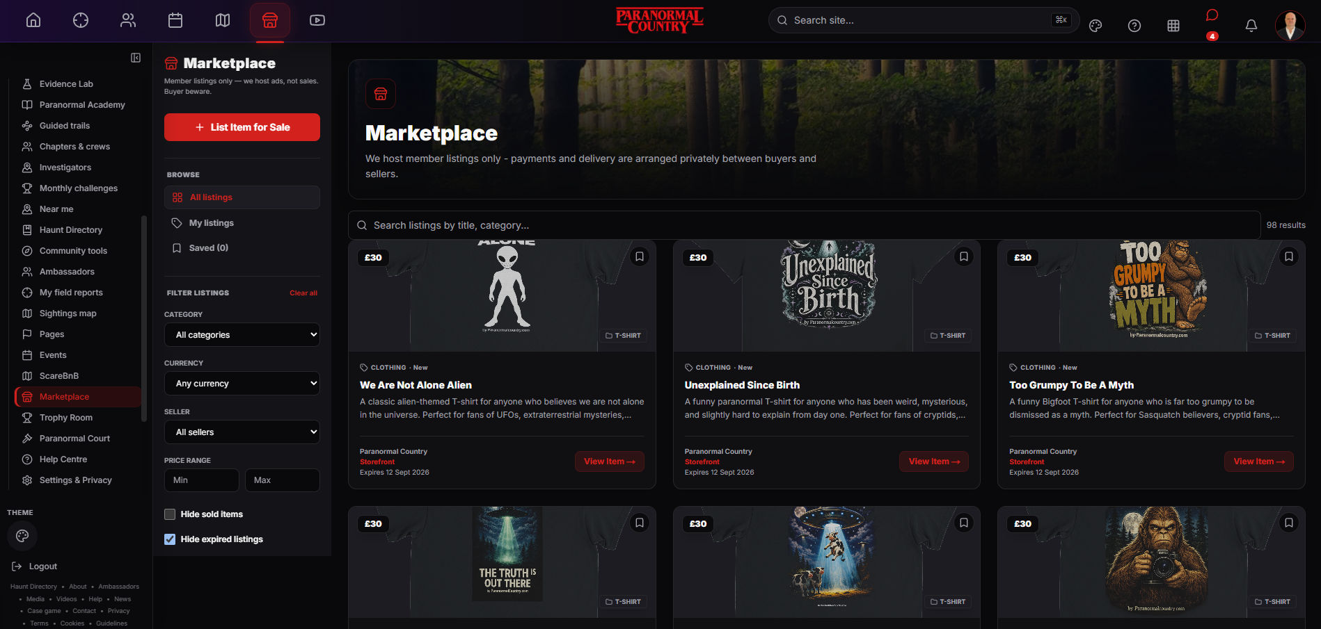
COMMERCE
29
Marketplace
Member listings for paranormal gear, books, clothing and collectibles.
FEATURE SUMMARY
The Marketplace lets members list, search, save and filter items. Paranormal Country hosts the listings, while payment and delivery are arranged privately between buyer and seller.
TALKING POINTS
Search and filter member listings
Seller identity remains connected to the community
Buyer caution is stated clearly
LIVE PLATFORM VIEW · JULY 2026
PARANORMALCOUNTRY.COM
COMMERCE • EXPLORE • INVESTIGATE • BELIEVE
Notes:
Member listings for paranormal gear, books, clothing and collectibles.
The Marketplace lets members list, search, save and filter items. Paranormal Country hosts the listings, while payment and delivery are arranged privately between buyer and seller.
Talking points:
• Search and filter member listings
• Seller identity remains connected to the community
• Buyer caution is stated clearly
Presenter guidance:
The marketplace is a community listing service rather than a full checkout system. Members can assess the listing and seller presence, but they remain responsible for payment, delivery and sensible scam precautions.

Slide 30
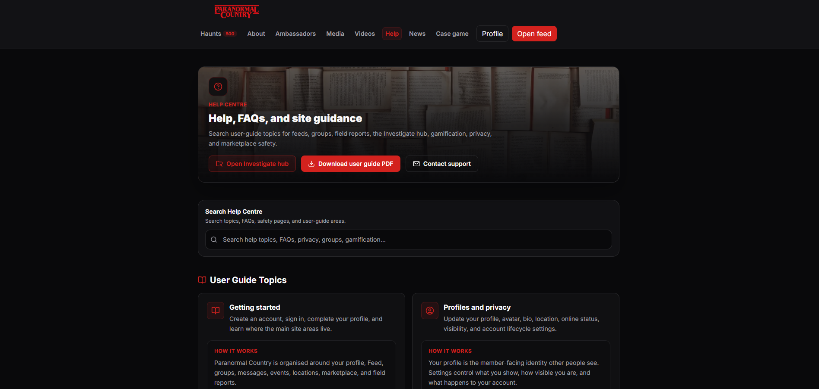
SUPPORT
30
Help Centre
Searchable guidance for getting started, privacy, research and safety.
FEATURE SUMMARY
The Help Centre combines searchable topics, detailed guides, a downloadable user guide and direct support contact. It explains both how features work and the standards around them.
TALKING POINTS
Search help topics and FAQs
Downloadable guide supports offline reference
Direct route to contact support
LIVE PLATFORM VIEW · JULY 2026
PARANORMALCOUNTRY.COM
SUPPORT • EXPLORE • INVESTIGATE • BELIEVE
Notes:
Searchable guidance for getting started, privacy, research and safety.
The Help Centre combines searchable topics, detailed guides, a downloadable user guide and direct support contact. It explains both how features work and the standards around them.
Talking points:
• Search help topics and FAQs
• Downloadable guide supports offline reference
• Direct route to contact support
Presenter guidance:
The Help Centre is part of the trust model. Members should be able to understand the platform, privacy settings and safety expectations without needing to guess or rely on informal advice.

Slide 31
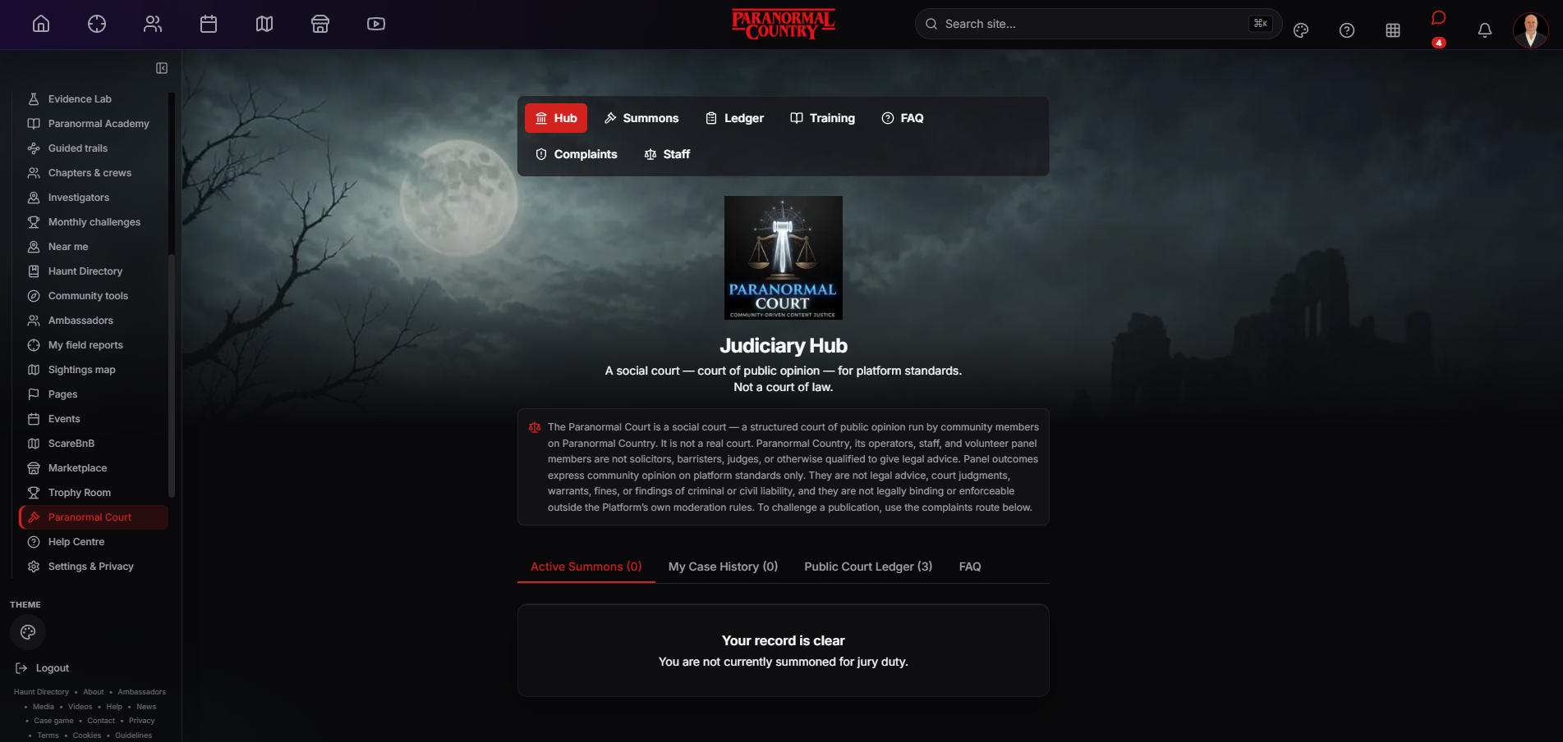
STANDARDS
31
Paranormal Court
A structured community standards process — not a court of law.
FEATURE SUMMARY
Paranormal Court provides training, summons, complaints and a public outcome ledger for platform standards. It records community opinion and has no legal authority.
TALKING POINTS
Juror training comes before participation
Reasons and outcomes are recorded
The process is explicitly non-legal
LIVE PLATFORM VIEW · JULY 2026
PARANORMALCOUNTRY.COM
STANDARDS • EXPLORE • INVESTIGATE • BELIEVE
Notes:
A structured community standards process — not a court of law.
Paranormal Court provides training, summons, complaints and a public outcome ledger for platform standards. It records community opinion and has no legal authority.
Talking points:
• Juror training comes before participation
• Reasons and outcomes are recorded
• The process is explicitly non-legal
Presenter guidance:
This is a distinctive community moderation concept, but it must always be described accurately. It is a transparent social process for platform standards, not legal advice, a court judgment or an enforceable finding outside the site.

Slide 32

FIND YOUR PEOPLE.
FOLLOW THE EVIDENCE.
GO FURTHER.
JOIN FREE
Built for experiencers, investigators, creators and the curious — with public ways to explore before joining.
paranormalcountry.com
EXPLORE • INVESTIGATE • BELIEVE
HAUNT DIRECTORY • CASE GAME • NEWS • COMMUNITY
Paranormal Country • Visual platform tour • July 2026
Notes:
Close by returning to the member journey: discover, document, meet and belong.
Invite the audience to scan the QR code or visit paranormalcountry.com.
Membership is free.

